Slide 1
Intro to Optimization
Practical AI for Practical Problems

Slide 2
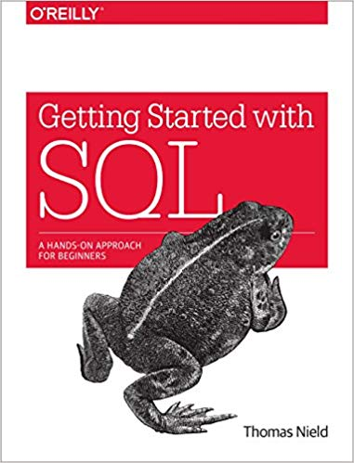


About the Speaker
Thomas Nield
Business Consultant, Operations Research for Southwest Airlines
Author of Getting Started with SQL by O'Reilly and Learning RxJava by Packt
My other online trainings at O'Reilly:
SQL Fundamentals for Data
Intermediate SQL for Data Analytics
Intro to Mathematical Optimization
Machine Learning from Scratch
thomasnield9727
https://github.com/thomasnield

Slide 3
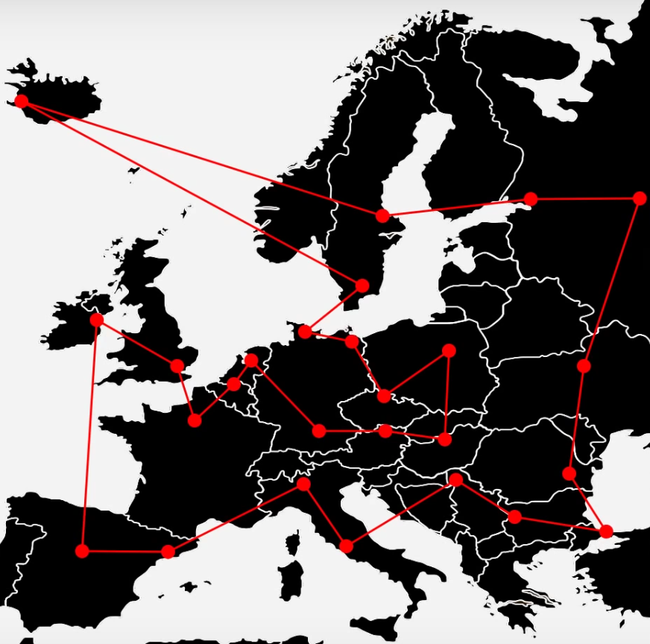
Agenda
Here is what we will do for the next 3 hours:
1
Introduction and what to expect
2
Local search algorithms using Metaheuristics
3
Search algorithms using Tree Search, Constraint Programming, and Branch and Bound
4
Convex optimization using Linear, Integer, and Mixed Programming.
5
Gradient descent and its role in machine learning

Slide 4
What Problems Will We Solve?
Some fun problems we will talk about!
1
Linear regressions from scratch
2
Finding shortest tour with Traveling Salesman Problem
3
Solving a Sudoku puzzle and scheduling classes
4
Manufacturing and blending problems
5
Neural networks and gradient descent

Slide 5
Section I Intro and Overview

Slide 6
Demo: The Traveling Salesman

Slide 7
Why Learn Optimization?
Machine learning is quite the rage these days, so much that it’s easy to overlook the fact there are other algorithms in the “artificial intelligence” space.
Our world economies and everyday lives are optimized algorithmically.
Transportation network design and on-time performance
Scheduling constrained resources like staff, transportation, server jobs, classrooms, events, etc.
Optimizing cost/revenue/profit objectives by mixing the right decision variables.
Solving move-based games like Sudoku and Chess
Machine learning itself is an optimization problem, as you are trying to minimize a loss function and can use techniques beyond just gradient descent.
Learn More: https://en.wikipedia.org/wiki/Mathematical_optimization

Slide 8
Machine Learning vs Optimization vs AI
Machine Learning
Optimization
Loss Minimization
Artificial Intelligence

Slide 9
Discrete versus Continuous Variables
Before we get started, it is critical we define discrete versus continuous variables.
Discrete Variables – Deals with whole numbers, sets, and “countable” entities
Continuous Variables – Deals with decimals, fractions, and a range of infinitely many values
Discrete optimization is dominant in real-world optimization, and is easier to reason with but harder to compute.
Continuous optimization is harder to reason with but easier to compute, while requiring more mathematical knowledge (linear algebra, calculus)

Slide 10
What is Discrete Optimization?
Discrete optimization is a space of algorithms that tries to find a feasible or optimal solution to a constrained problem with a “discrete” nature.
Scheduling classrooms, staff, transportation, sports teams, and manufacturing
Finding an optimal route for vehicles to visit multiple destinations
Optimizing manufacturing operations
Solving a Sudoku or Chess game
Discrete optimization is a mixed bag of algorithms and techniques, which can be built from scratch or with the assistance of a library.
10

Slide 11
What is Continuous Optimization?
Continuous optimization is a space of algorithms that tries to find a feasible or optimal solution to a constrained problem with a “continuous” nature.
Finding an optimal mix of investments in a portfolio
Fitting a percentage of on-time performance to historical transportation data
Mixing food ingredients while minimizing costs with various suppliers.
Minimizing loss by calculating the optimal weights for a neural network
Continuous optimization is ideally solved with linear programming or calculus techniques (e.g. gradient descent), but can also employ random-based algorithms.

Slide 12
Section II Metaheuristics and Random Search

Slide 13

What Are Search Algorithms?
Search algorithms take a problem with variables and try to find the right values to achieve a specific outcome.
What’s the shortest round-trip tour to visit several cities?
What time should I schedule worker shifts while respecting their hourly limits and vacation requests?
Which numbers will solve my Sudoku?
Given factory capacity, how much of Product X versus Product Y should I make to maximize profit?
What weight values will minimize the loss function of my neural network?

Slide 14
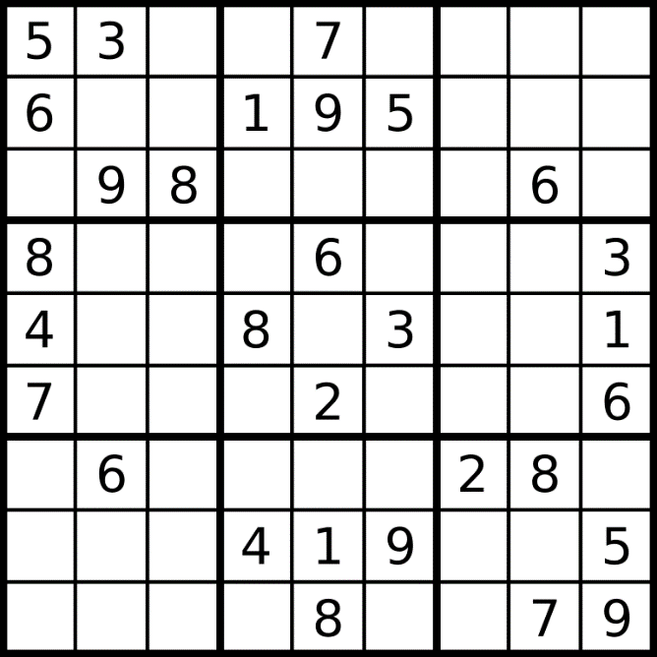
What Are Search Algorithms?
The most naive way to solve these problems is using iterative brute-force, but this will never be practical because it will effectively take forever to compute outside of trivial problems.
We will need some more clever techniques!

Slide 15
What Are Metaheuristics?
Metaheuristics are a powerful tool to find a solution to an optimization problem.
Highly flexible, can be relatively easy to code from scratch
Algorithms leverage controlled randomness, which is called stochastic programming
A heuristic is a clever strategy to guide a search algorithm to a more likely solution.
Example: if maximizing revenue with limited factory capacity, prefer high-value items first in your search
More generally, heuristics will start searches where a solution is more likely, and deprioritize less likely solutions.
Metaheuristics will apply a variety of heuristics, essentially using a heuristic that manages a heuristics
https://en.wikipedia.org/wiki/Metaheuristic
https://en.wikipedia.org/wiki/Stochastic_optimization
https://en.wikipedia.org/wiki/Heuristic

Slide 16






Traveling Salesman Problem
The Traveling Salesman Problem (TSP) is one of the most elusive and studied computer science problems since the 1950’s.
Also serves as a benchmark for transportation and routing problems.
Objective: Find the shortest round-trip tour across several geographic points/cities.
The Challenge: Just 60 cities = 8.3 x 10⁸¹ possible tours
That’s more tour combinations than there are observable atoms in the universe!
16

Slide 17

Metaheuristic – Hill Climbing
Start with a random solution, even if it is poor quality.
Repeat the following steps for a number of iterations and/or until the solution cannot improve anymore.
Select a random part of the solution and change it.
If that results in an improvement, keep it.
Easy, right? But there is a problem…
1
2

Slide 18
Demo: Walking Through Hill Climbing

Slide 19
Tour Distance
Tour Configurations

Slide 20
LOCAL MINIMUM
Tour Distance
GLOBAL MINIMUM
Tour Configurations

Slide 21
Tour Distance
Tour Configurations

Slide 22
Tour Distance
Tour Configurations

Slide 23
Tour Distance
Greedy algorithm gets stuck
Tour Configurations

Slide 24
Tour Distance
We really want to be here
Tour Configurations

Slide 25
Tour Distance
Or even here
Tour Configurations

Slide 26
Tour Distance
How do we escape?
Tour Configurations

Slide 27
Tour Distance
Make me slightly less greedy!
Tour Configurations

Slide 28
Tour Distance
Occasionally allow a marginally inferior move...
Tour Configurations

Slide 29
Tour Distance
To find superior solutions!
Tour Configurations

Slide 30
Tour Distance
To find superior solutions!
Tour Configurations

Slide 31
When we have many local minima/maxima, it is because this problem is non-convex
Tour Distance
Tour Configurations

Slide 32



Convex versus Non-Convex
Convex

Slide 33
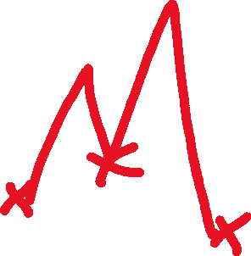
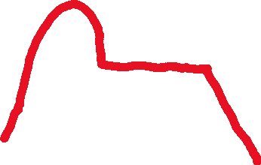
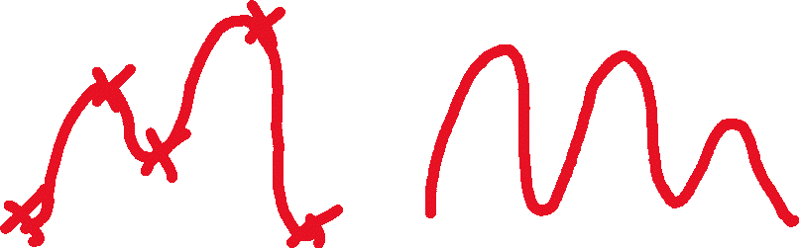
Convex versus Non-Convex
Plateau!
Non-Convex

Slide 34
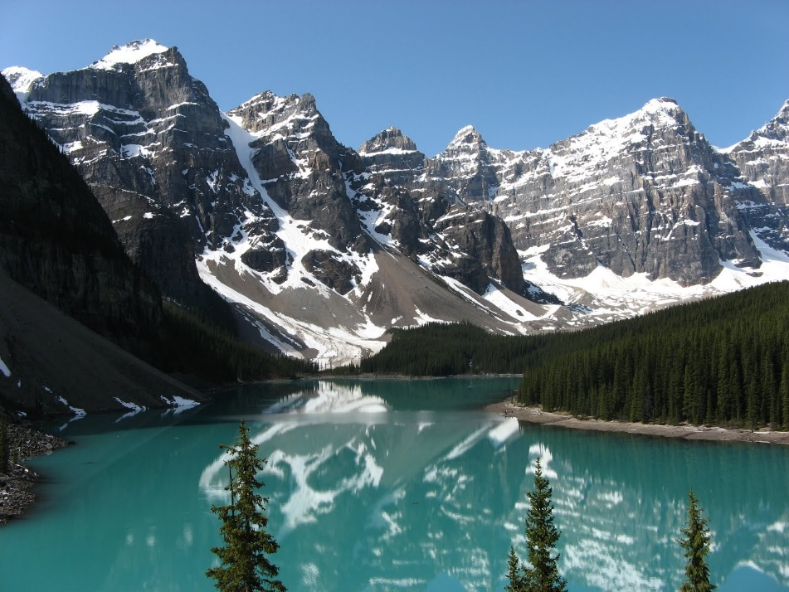
Convex versus Non-Convex
If all problems were convex, optimization and machine learning would be easy because there would only be one global minimum or maximum.
Unfortunately, this is often not the case and it is easy to get stuck in a local minimum or maximum.
This is why stochastic (randomized) searches are a common solution to finding a better minimum/maximum when many exist.
This Photo by Unknown Author is licensed under CC BY-NC-ND

Slide 35
Simulated Annealing
Simulated annealing is another metaheuristic similar to hill-climbing, but it periodically allows inferior moves hoping it will lead to better solutions.
It can be surprisingly versatile, and used to optimize problems ranging from the Traveling Salesman to tuning neural networks.
So how do you determine whether to keep an inferior move?
A temperature schedule throttles periodically between greediness (don’t accept an inferior move) and randomness (accept an inferior move).
A given temperature on the given iteration will result in a weighted coin flip, and that coin flip will determine whether the inferior move is accepted or not.

Slide 36
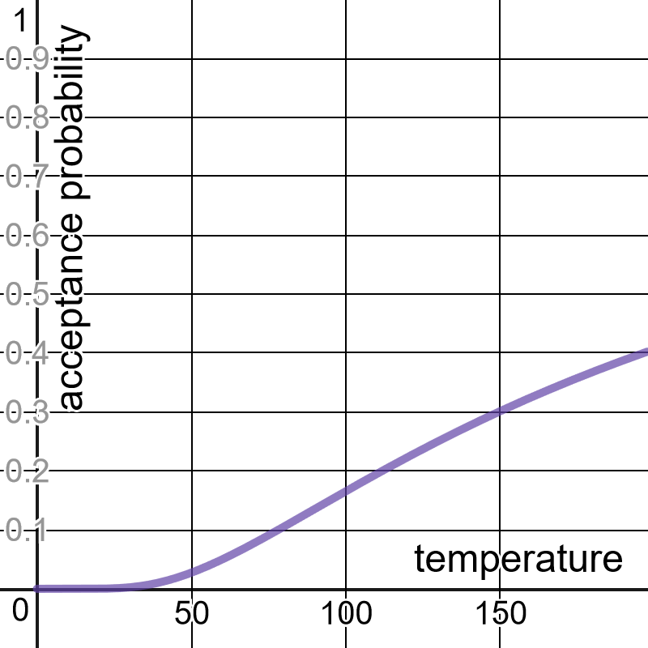
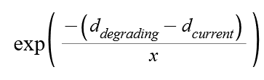
Calculating the Weighted Coin Flip Probability
Where x is a given temperature, here is how to convert it into a probability of accepting an inferior move.
d_{degrading} and d_{current} reflect the inferior distance and current distance of the move respectively.
https://www.desmos.com/calculator/rpfpfiq7ce

Slide 37

Metaheuristic - Simulated Annealing
1
Start with a random solution, even if it is poor quality.
At each given temperature/iteration, do the following steps:
Select a random variable in the solution and change it.
If that results in an improvement, keep it.
If the result is inferior, flip a weighted coin based on the temperature and degradation of the move to determine whether to keep it.
If your solution is not acceptable, modify your temperature schedule and try again.
2
This Photo by Unknown Author is licensed under CC BY-NC
3

Slide 38
Demo: Walking Through Simulated Annealing

Slide 39
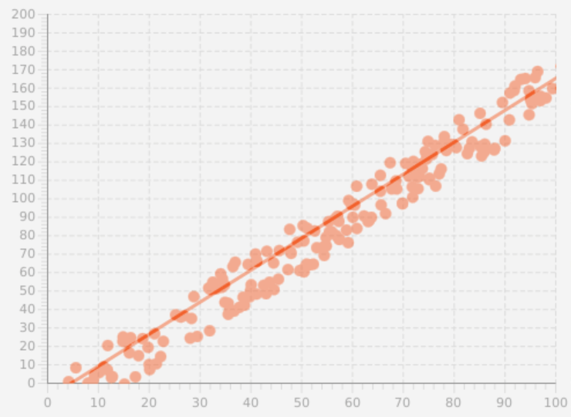
Metaheuristics for Linear Regression
Let’s use hill climbing/simulated annealing for a simple problem with continuous variables: linear regression.
A simple linear regression fits a line of the form y = mx + b, where we find the best m and b values that fit the points, minimizing the sum of least squared differences.
Note: For an intuitive graph demonstration sum of least squares fitting: https://www.desmos.com/calculator/lywhybetzt

Slide 40
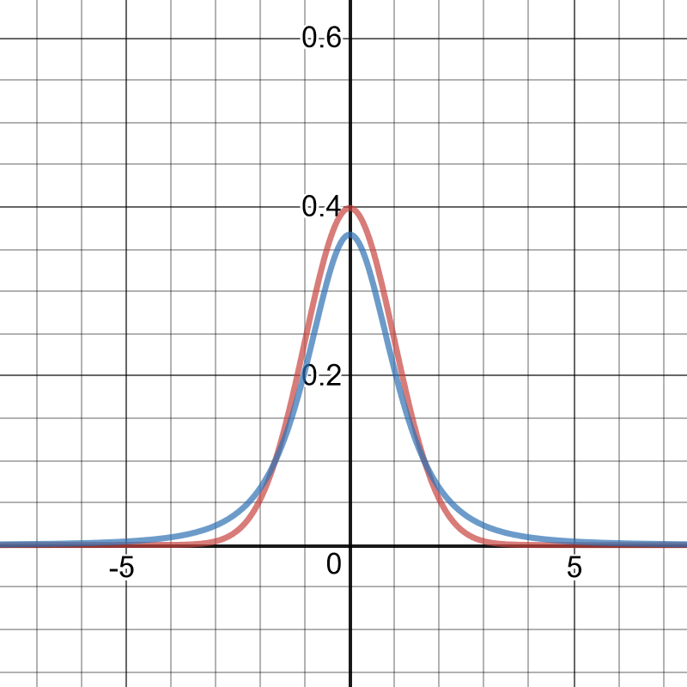
Metaheuristics for Linear Regression
Since they are continuous and not discrete, how do we randomly change values for m or b?
We randomly increase/decrease m and b with random values from a standard normal distribution, or even better a T-Distribution which has fatter tails.
Fatter tails = more larger adjustments = more diverse moves.
We can use these random adjustments to m and b as our moves in hill climbing and simulated annealing.
Normal distribution
T-distribution
https://www.desmos.com/calculator/xm56tvvalh

Slide 41
Demo: Linear Regression

Slide 42
Metaheuristics for Quantile Regression
What’s cool about building search algorithms is we can pursue weird and niche objectives even if we have incomplete information or no mathematical model, which happens often in the real world.
This may not yield the most efficient or precise approach, but it can be effective nonetheless. For example, quantile regression is just like linear regression, but it puts a percentage of points under the line.
If you want 80% of the point to fall under the line, you can quickly build a search algorithm seeking that objective rather than having to deep dive into niche Calculus concepts.

Slide 43
Demo: Quantile Regression

Slide 44
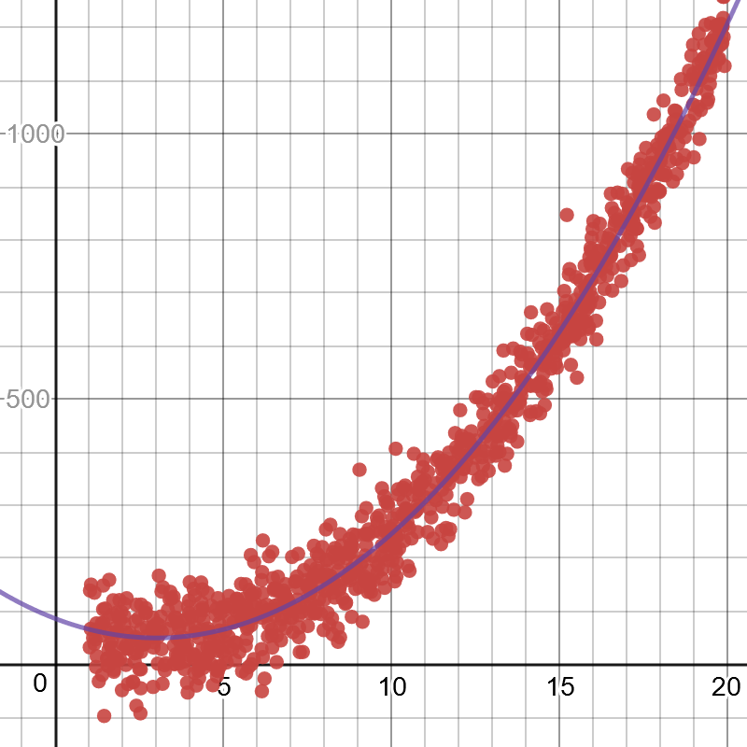
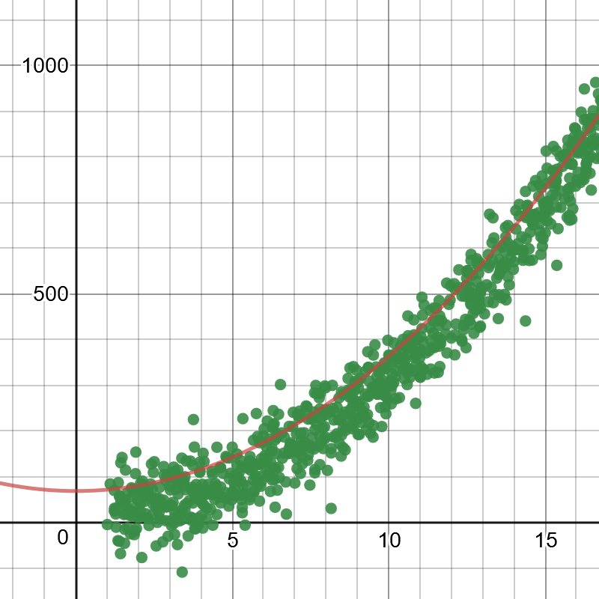
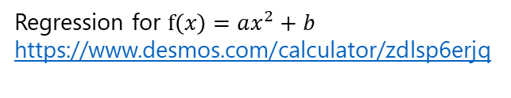
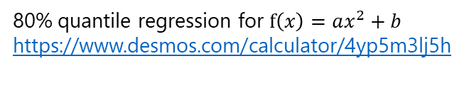
Use Metaheuristics for Nonlinear Regressions Too!
Regression for $f\left(x\right)=ax^{2}+b$
https://www.desmos.com/calculator/zdlsp6erjq
80% quantile regression for $f\left(x\right)=ax^{2}+b$
https://www.desmos.com/calculator/4yp5m3lj5h

Slide 45
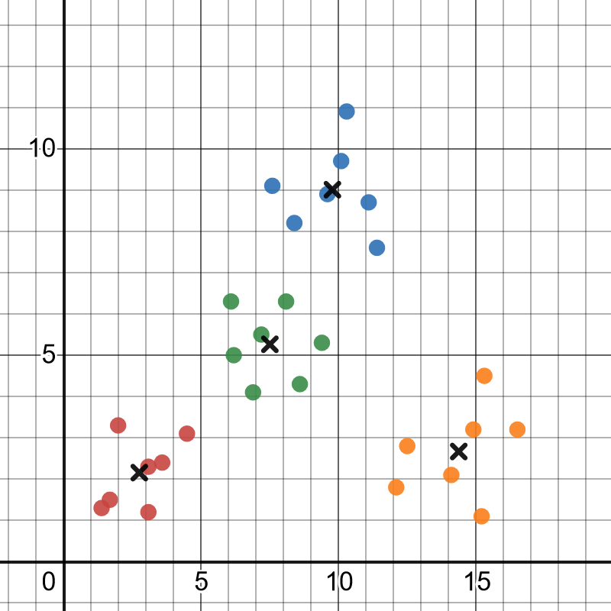
Hill Climbing and K-Means Clustering
import pandas as pd import numpy as np import random # Desmos graph: https://www.desmos.com/calculator/pb4ewmqdvy class Point: def __init__(self, x, y): self.x = x self.y = y def __str__(self): return "{0},{1}".format(self.x, self.y) def distance_between(point1, point2): return pow(pow(point2.x - point1.x, 2) + pow(point2.y - point1.y, 2), .5) k = 4 points = [(Point(row.x,row.y)) for index, row in pd.read_csv("https://tinyurl.com/y25lvxug").iterrows() ] centroids = [Point(0, 0) for i in range(k)] best_loss = 1_000_000_000.0 for i in range(100_000): random_centroid = random.choice(centroids) random_x_adjust = np.random.standard_normal() random_y_adjust = np.random.standard_normal() random_centroid.x += random_x_adjust random_centroid.y += random_y_adjust new_loss = 0.0 for p in points: new_loss += pow(min([distance_between(p,c) for c in centroids]), 2) if new_loss < best_loss: best_loss = new_loss else: random_centroid.x -= random_x_adjust random_centroid.y -= random_y_adjust for c in centroids: print(c)
https://tinyurl.com/yy8lzvtt

Slide 46
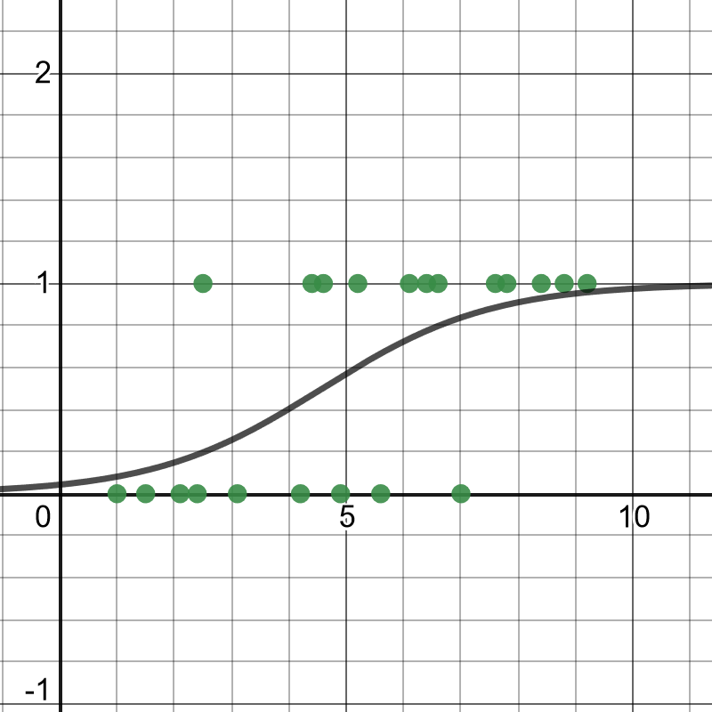
Hill Climbing and Logistic Regression
import random import numpy as np import pandas as pd import math # Desmos graph: https://www.desmos.com/calculator/6cb10atg3l class Point: def __init__(self, x, y): self.x = x self.y = y def __str__(self): return "{0},{1}".format(self.x, self.y) points = [(Point(row.x, row.y)) for index, row in pd.read_csv("https://tinyurl.com/y2cocoo7").iterrows()] best_likelihood = -10_000_000 b0 = .01 b1 = .01 # calculate maximum likelihood def predict_probability(x): p = 1.0 / (1.0 + math.exp(-(b0 + b1 * x))) return p for i in range(1_000_000): # Select b0 or b1 randomly, and adjust it randomly random_b = random.choice(range(2)) random_adjust = np.random.normal() if random_b == 0: b0 += random_adjust elif random_b == 1: b1 += random_adjust true_estimates = sum(math.log(predict_probability(p.x)) for p in points if p.y == 1.0) false_estimates = sum(math.log(1.0 - predict_probability(p.x)) for p in points if p.y == 0.0) total_likelihood = true_estimates + false_estimates if best_likelihood < total_likelihood: best_likelihood = total_likelihood elif random_b == 0: b0 -= random_adjust elif random_b == 1: b1 -= random_adjust print("1.0 / (1 + exp(-({0} + {1}*x))".format(b0, b1)) print("BEST LIKELIHOOD: {0}".format(best_likelihood))
https://tinyurl.com/y6ye8vzr

Slide 47
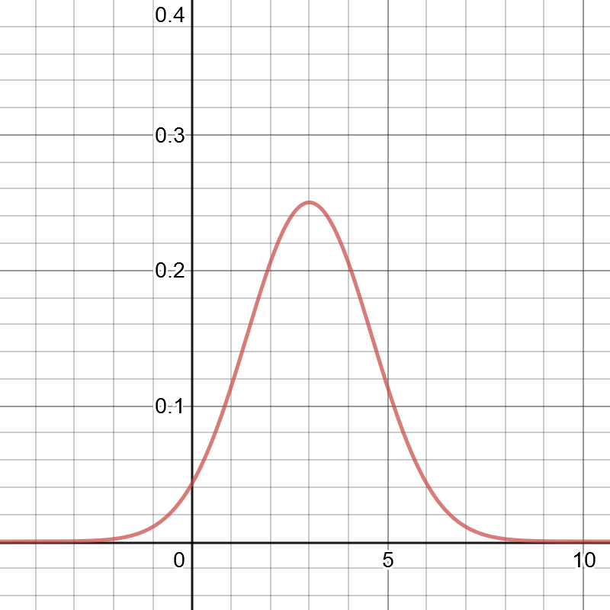
Hill Climbing and Fitting a Probability Distribution
import random, math observations = [1.0, 1.0, 1.0, 2.0, 2.0, 3.0, 4.0, 4.0, 5.0, 5.0, 5.0] def normal_pdf(x: float, mean: float, std_dev: float) -> float: return (1.0 / (2.0 * math.pi * std_dev ** 2) ** 0.5) * math.exp(-1.0 * ((x - mean) ** 2 / (2.0 * std_dev ** 2))) best_likelihood = 0.0 std_dev = 1.0 mean = 1.0 for i in range(100_000): adj = random.normalvariate(0, 1) selected_variable = random.randint(0, 1) if selected_variable == 0: mean += adj elif selected_variable == 1: std_dev += adj likelihood = math.exp(sum([math.log(.000000001 + normal_pdf(x, mean, std_dev)) for x in observations])) if likelihood > best_likelihood: best_likelihood = likelihood elif selected_variable == 0: mean -= adj elif selected_variable == 1: std_dev -= adj print("mean={0}, std_dev={1}".format(mean, std_dev))

Slide 48
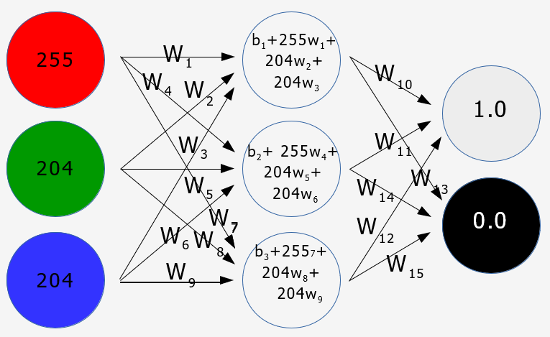
Simulated Annealing and Neural Networks
import numpy as np import pandas as pd from scipy import special training_data = pd.read_csv("https://tinyurl.com/y2qmhfsr") training_data_count = len(training_data.index) # Learning rate controls how slowly we approach a solution # Make it too small, it will take too long to run. # Make it too big, it will likely overshoot and miss the solution. learning_rate = 0.1 # Extract the input columns, scale down by 255 training_inputs = training_data.iloc[:, 0:3].values.transpose() / 255 # Extract output column, and generate an opposite column where 1 is 0 and 0 is 1. actual_outputs = np.vstack( (training_data.iloc[:, -1].values.transpose(), -1 * (training_data.iloc[:, -1].values.transpose() - 1))) # Build neural network with weights and biases middle_weights = np.random.rand(3, 3) output_weights = np.random.rand(2, 3) middle_bias = np.random.rand(3, 1) output_bias = np.random.rand(2, 1) best_middle_weights = None best_output_weights = None best_middle_bias = None best_output_bias = None # Activation functions def relu(x): return np.maximum(x, 0) def softmax(x): return special.softmax(x, axis=0) def tanh(x): return np.tanh(x) best_loss = 10_000_000_000 # Execute training with simulated annealing # This is similar to hill-climbing except it occasionally allows inferior moves hoping to find a better solution # This is covered in depth in another online training "Intro to Mathematical Optimization" epochs = 1_000_000 temperature = 120.0 decrement = temperature / epochs new_loss = 1_000_000_000.0 for i in range(epochs): temperature -= decrement current_loss = new_loss # 20 hyper-parameters to randomly select from # Each parameter needs to be uniformly likely to be selected # So we will use some random number strategies to random_select = np.random.randint(0, 20) random_adjust = np.random.normal() * learning_rate random_row = 0 random_col = 0 # Randomly adjust middle layer weight if random_select < 9: random_row = np.random.randint(0, 3) random_col = np.random.randint(0, 3) if middle_weights[random_row, random_col] + random_adjust < -1.0: random_adjust = -1.0 - middle_weights[random_row, random_col] if middle_weights[random_row, random_col] + random_adjust > 1.0: random_adjust = 1.0 - middle_weights[random_row, random_col] middle_weights[random_row, random_col] += random_adjust # Randomly adjust outer layer weight elif random_select < 15: random_row = np.random.randint(0, 2) random_col = np.random.randint(0, 3) if output_weights[random_row, random_col] + random_adjust < -1.0: random_adjust = -1.0 - output_weights[random_row, random_col] if output_weights[random_row, random_col] + random_adjust > 1.0: random_adjust = 1.0 - output_weights[random_row, random_col] output_weights[random_row, random_col] += random_adjust # Randomly adjust middle layer bias elif random_select < 18: random_row = np.random.randint(3) random_col = 0 if middle_bias[random_row, random_col] + random_adjust < 0.0: random_adjust = 0.0 - middle_bias[random_row, random_col] if middle_bias[random_row, random_col] + random_adjust > 1.0: random_adjust = 1.0 - middle_bias[random_row, random_col] middle_bias[random_row, random_col] += random_adjust # Randomly adjust outer layer bias elif random_select < 20: random_row = np.random.randint(2) random_col = 0 if output_bias[random_row, random_col] + random_adjust < 0.0: random_adjust = 0.0 - output_bias[random_row, random_col] if output_bias[random_row, random_col] + random_adjust > 1.0: random_adjust = 1.0 - output_bias[random_row, random_col] output_bias[random_row, random_col] += random_adjust # Calculate outputs with the given weights, biases, and activation functions for all three layers training_outputs = softmax(output_bias + output_weights.dot(tanh(middle_bias + middle_weights.dot(training_inputs)))) # Calculate the mean squared loss new_loss = np.sum((actual_outputs - training_outputs) ** 2) / training_data_count # If the loss improves, keep the random adjustment. Otherwise revert. if new_loss < best_loss: best_loss = new_loss print("TEMP {0}, LOSS {1}->{2}".format(temperature,current_loss,new_loss)) current_loss = new_loss # Save solution best_middle_weights = middle_weights.copy() best_output_weights = output_weights.copy() best_middle_bias = middle_bias.copy() best_output_bias = output_bias.copy() elif new_loss < current_loss: current_loss = new_loss # Do a weighted coin flip based on temperature to determine whether to accept inferior move elif np.random.uniform(0, 1) <= np.exp((-(new_loss - current_loss)) / temperature): current_loss = new_loss #print("{0}<-{1}".format(new_loss,current_loss)) # Undo the random adjust if loss hasn't improved or coin flip fails elif random_select < 9: middle_weights[random_row, random_col] -= random_adjust elif random_select < 15: output_weights[random_row, random_col] -= random_adjust elif random_select < 18: middle_bias[random_row, random_col] -= random_adjust elif random_select < 20: output_bias[random_row, random_col] -= random_adjust # Set best solution middle_weights = best_middle_weights output_weights = best_output_weights middle_bias = best_middle_bias output_bias = best_output_bias # Interact and test with new colors def predict_probability(r, g, b): input_colors = np.array([r, g, b]).transpose() / 255 output = softmax(output_bias + output_weights.dot(tanh(middle_bias + middle_weights.dot(input_colors)))) return output def predict_font_shade(r, g, b): output_values = predict_probability(r, g, b) if output_values[0, 0] > output_values[1, 0]: return "DARK" else: return "LIGHT" while True: n = input("Predict light or dark font. Input values R,G,B: ") (r, g, b) = n.split(",") print(predict_font_shade(int(r), int(g), int(b)))
https://tinyurl.com/yxojew66

Slide 49
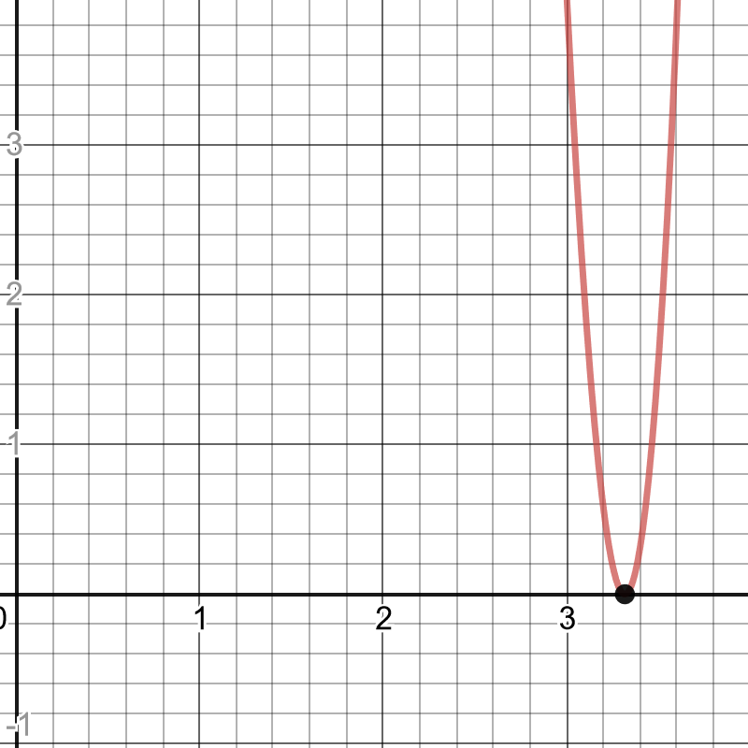
Hill Climbing to Find Square and N-Roots
import numpy as np # Use hill climbing to estimate a square root value = 11.0 sqrt_candidate = value / 2.0 for i in range(100000): adjust = np.random.standard_t(3, 1)[0] new_candidate = sqrt_candidate + adjust if (value - sqrt_candidate ** 2) ** 2 > (value - new_candidate ** 2) ** 2: sqrt_candidate = new_candidate print(sqrt_candidate) # prints 3.316622346827584

Slide 50
Other Metaheuristics Algorithms
Hill Climbing and Simulated Annealing are practical workhorses for a lot of optimization problems
There are many other metaheuristics algorithms, some of which you might have heard of:
Genetic algorithms
Tabu search
Ant colony optimization
Evolutionary algorithms
K-Opt
Go down the rabbit hole: https://en.wikipedia.org/wiki/Metaheuristic

Slide 51
Optimization Algorithms Ranking
Algorithm | Scalable | Optimal | Easy to Use | Tweakable
Brute Force | 0/5 | 5/5 | 5/5 | 0/5
Branch and Bound | 0/5 | 5/5 | 4/5 | 2/5
Hill Climbing | 5/5 | 2/5 | 4/5 | 3/5
Tabu Search | 5/5 | 4/5 | 3/5 | 5/5
Simulated Annealing | 5/5 | 4/5 | 2/5 | 5/5
Late Acceptance | 5/5 | 4/5 | 3/5 | 5/5
Step Counting Hill Climbing | 5/5 | 4/5 | 3/5 | 5/5
Variable Neighborhood Descent | 3/5 | 3/5 | 2/5 | 5/5
Evolutionary Strategies | 3/5 | 3/5 | 2/5 | 5/5
Genetic Strategies | 3/5 | 3/5 | 2/5 | 5/5
SOURCE: https://docs.optaplanner.org/7.11.0.Final/optaplanner-docs/html_single/index.html#searchSpaceSize

Slide 52
Optimization Algorithms Ranking – Most Practical
Algorithm | Scalable | Optimal | Easy to Use | Tweakable
Brute Force | 0/5 | 5/5 | 5/5 | 0/5
Branch and Bound | 0/5 | 5/5 | 4/5 | 2/5
Hill Climbing | 5/5 | 2/5 | 4/5 | 3/5
Tabu Search | 5/5 | 4/5 | 3/5 | 5/5
Simulated Annealing | 5/5 | 4/5 | 2/5 | 5/5
Late Acceptance | 5/5 | 4/5 | 3/5 | 5/5
Step Counting Hill Climbing | 5/5 | 4/5 | 3/5 | 5/5
Variable Neighborhood Descent | 3/5 | 3/5 | 2/5 | 5/5
Evolutionary Strategies | 3/5 | 3/5 | 2/5 | 5/5
Genetic Strategies | 3/5 | 3/5 | 2/5 | 5/5
SOURCE: https://docs.optaplanner.org/7.11.0.Final/optaplanner-docs/html_single/index.html#searchSpaceSize

Slide 53
Pros and Cons of Metaheuristics
Pros | Cons
Performs relatively quickly for large problems Works with limited computational resources Relatively easy to implement and explain, even to nontechnical people Can be used when information about the model is incomplete or imperfect If you’re better at programming than you are at math, metaheuristics are for you! | Does not guarantee an optimal solution, only an “acceptable” one. Does not guarantee a deterministic solution, and can produce different results with each execution. Like most models, it will require tinkering and experimentation with hyperparameters before it provides an acceptable answer (no free lunch theorem).

Slide 54
No Free Lunch Theorem
In machine learning and optimization, an unfortunate reality is you will need to customize models to every problem.
A given temperature schedule can work well with one Traveling Salesman Problem, but not as well with another.
A set of weights for one deep learning problem recognizing cats will not work with another recognizing dogs.
This is know as the no free lunch theorem, and because of it you should rarely expect a silver bullet implementation of any algorithm. You will always need to experiment with parameters and manually adapt to new situations.
https://en.wikipedia.org/wiki/No_free_lunch_in_search_and_optimization

Slide 55
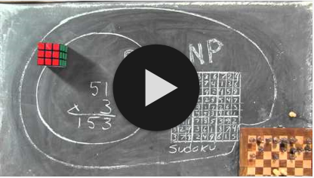

P Versus NP Problem
Another problem to be aware of in optimization and machine learning is the P versus NP problem.
If P = NP, that would mean solutions to hard problems (like optimization and machine learning) can be calculated just as quickly as they are verified.
Think of Sudokus: it’s quick to verify if a Sudoku solution is valid, but it takes much longer to solve for a solution.
While P = NP has been neither proven or disproven in the past 50 years, more scientists are coming to believe P does not equal NP.
This is a major limitation to the capabilities of machine learning and optimization, as it means complexity will always limit what we can do.
YouTube – The P versus NP Problem
The Traveling Salesman (2012 Thriller Film)

Slide 56
“Clouds are not spheres, mountains are not cones, coastlines are not circles, and bark is not smooth, nor does lightning travel in a straight line.”
― Benoît Mandelbrot

Slide 57

Quiz Time!
Metaheuristics algorithms (like hill climbing and simulated annealing) guarantee the most optimal solution.
True
False
A
B

Slide 58
Quiz Time!
Metaheuristics algorithms (like hill climbing and simulated annealing) guarantee the most optimal solution.
True
False
A
B
Metaheuristics algorithms are random-based searches, and can only guarantee an approximation if executed correctly.

Slide 59
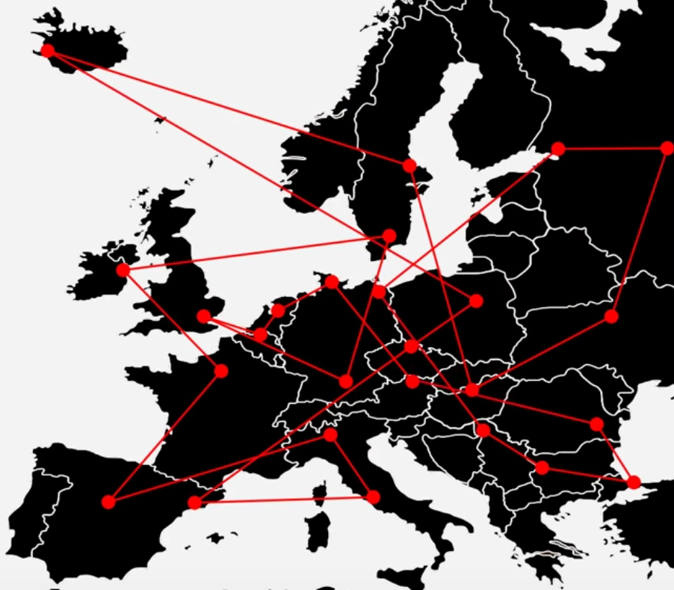
Quiz Time!
You used Hill Climbing to find a solution to the Traveling Salesman Problem. However, you noticed that when it finished, many overlaps still exist indicating a poor solution. Which of these is the more likely problem?
There were too many iterations
There were not enough iterations
A
B

Slide 60
Quiz Time!
You used Hill Climbing to find a solution to the Traveling Salesman Problem. However, you noticed that when it finished, many overlaps still exist indicating a poor solution. Which of these is the more likely problem?
There were too many iterations
There were not enough iterations
A
B
Hill-climbing should converge on a local minimum where overlaps do not exist anymore. If there are still overlaps, it means the algorithm did not do enough random samples and swaps. Therefore it needs more iterations.

Slide 61
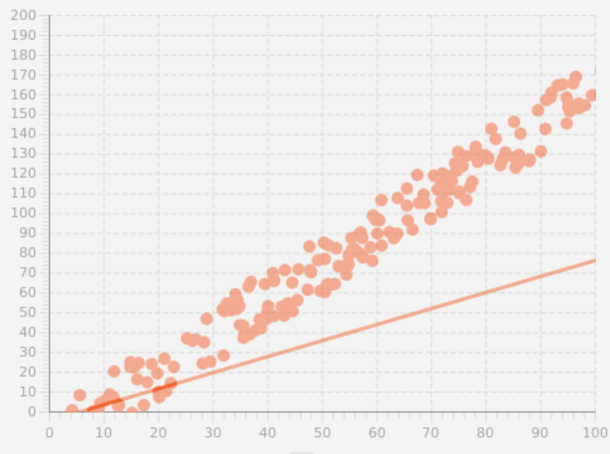
Quiz Time!
Hill climbing was used for a linear regression. However, starting from a flat position, the line has stopped well below the points and clearly did not fit to them. Which of these could be the more likely cause?
There were too many iterations
There were not enough iterations
A
B

Slide 62
Quiz Time!
Hill climbing was used for a linear regression. However, starting from a flat position, the line has stopped well below the points and clearly did not fit to them. Which of these could be the more likely cause?
There were too many iterations
There were not enough iterations
A
B
Again, hill climbing should converge on a local minimum. If the line started flat and prematurely stopped moving towards the points, it is likely it did not have enough iterations.

Slide 63
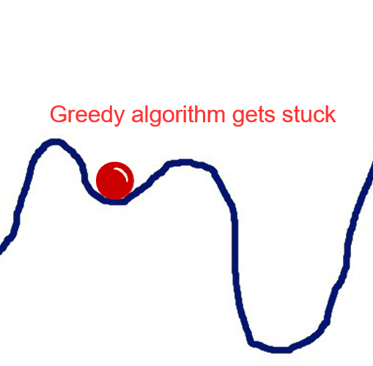
Quiz Time!
You are using simulated annealing to minimize cost of a factory line schedule. You know it is possible to achieve a cost of $20K or less, but your search algorithm consistently gets stuck around $21K. Which of these should you likely try next?
Switch from a Simulated Annealing to a Hill Climbing algorithm
Use a temperature schedule that periodically allows more randomness
Increase the number of iterations
A
B
C

Slide 64
Quiz Time!
You are using simulated annealing to minimize cost of a factory line schedule. You know it is possible to achieve a cost of $20K or less, but your search algorithm consistently gets stuck around $21K. Which of these should you likely try next?
Switch from a Simulated Annealing to a Hill Climbing algorithm
Use a temperature schedule that periodically allows more randomness
Increase the number of iterations
A
B
C
We are already using simulated annealing, but are stuck in a local minimum so our temperature schedule needs to be hotter. You need to introduce some more randomness, and hopefully that will “shake the ball” out of the local minimum it keeps getting stuck in.

Slide 65
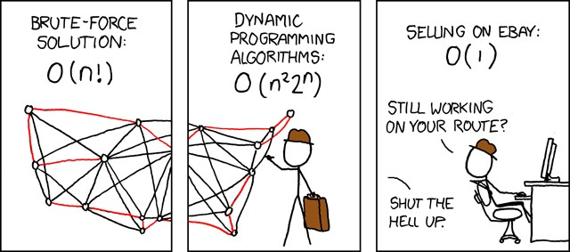
Source Code
Traveling Salesman Demo https://github.com/thomasnield/traveling_salesman_demo
Traveling Salesman Plotter https://github.com/thomasnield/traveling_salesman_plotter
Linear Regression App
https://github.com/thomasnield/kotlin_linear_regression/
SOURCE: xkcd.com

Slide 66
Section III Tree Search

Slide 67
Introducing Tree Search
Stochastic search algorithms, which rely on controlled randomness, can be effective and useful although they have drawbacks.
They are not deterministic and will likely provide an approximate and inconsistent solution every time it is executed.
This compromise is why they perform fast and with little computing resources.

Slide 68
Introducing Tree Search
Tree search is another search algorithm that is consistent, deterministic, and effectively exhaustive of all possible solutions but also has drawbacks.
The algorithm will explore every possible combination of solutions, minus the ones it knows will be infeasible.
This clever avoidance of infeasible solutions is done with a combination of heuristics, bounding, and pruning.
However, they can be demanding on computing resources and, in extreme cases, be downright impractical.

Slide 69
A Crash Course on Permutations
1 2 3 4 5
H
T
H
H
T
H
T
H
T
H
T
T
H
T
T
H
T
H
T
H
T
H
T
H
T
H
T
H
T
H
T
H
T
H
T
H
T
H
T
H
T
H
T
H
T
H
T
H
T
H
T
H
T
H
T
H
T
H
T
H
H
T
Suppose you had 5 coin flips, and you want to know all ordered combinations that yield 3 heads and 2 tails, such as HHHTT, HHTHT, TTHHH, and so on.
You can use a recursive function to generate a tree of all possible combinations, and keep the ones that include 3 heads and two tails.

Slide 70

A Crash Course on Permutations
1 2 3 4 5
H
T
H
H
T
H
T
H
T
H
T
T
H
T
T
H
T
H
T
H
T
H
T
H
T
H
T
H
T
H
T
H
T
H
T
H
T
H
T
H
T
H
T
H
T
H
T
H
T
H
T
H
T
H
T
H
T
H
T
H
H
T
Suppose you had 5 coin flips, and you want to know all ordered combinations that yield 3 heads and 2 tails, such as HHHTT, HHTHT, TTHH, and so on.
You can use a recursive function to generate a tree of all possible combinations, and keep the ones that include 3 heads and two tails.
However, if we have rules dictating specific outcomes, we can search this tree faster by avoiding combinations we know will not work.
Fun Tangent: The Binomial Distribution
https://www.youtube.com/watch?v=ConmIDAzRqI

Slide 71
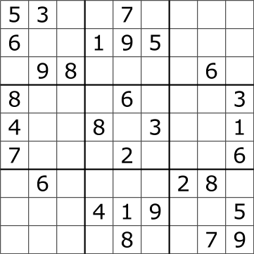
Consider the Sudoku
The Sudoku is hopefully a familiar game puzzle.
OBJECTIVE: Fill in the blank cells with numbers 1-9 so that every row, column, and square has the numbers 1-9.
We could use simulated annealing to solve this: start with a random solution and randomly swap numbers, minimizing the count of “infractions” until it is 0.
However, a tree search is going to make more sense here since Sudoku constraints can be leveraged to reduce the search space quickly.

Slide 72
Consider the Sudoku
[4,4] → 5
[7,7] → 3
[8,6] → 4
[1,4] → 2, 5
[0,7] → 2, 3
[3,2] → 2, 3
[4,2] → 3, 4
[5,2] → 2, 4
[3,5] → 5, 9
[5,5] → 1, 4
[4,6] → 3, 5
[5,8] → 2, 6
[6,7] → 3, 6
[2,6] → 1 , 7
[0,2] → 1, 2, 3
[1,3] → 1, 2, 5
…
[2,6] → 1,3,4,5,7,9
0 1 2 3 4 5 6 7 8
0
1
2
3
4
5
6
7
8
Put cells in a list sorted by possible candidate count

Slide 73
Solving the Sudoku
[4,4] → 5
[7,7] → 3
[8,6] → 4
[1,4] → 2, 5
[0,7] → 2, 3
[3,2] → 2, 3
[4,2] → 3, 4
[5,2] → 2, 4
[3,5] → 5, 9
[5,5] → 1, 4
[4,6] → 3, 5
[5,8] → 2, 6
[6,7] → 3, 6
[2,6] → 1 , 7
[0,2] → 1, 2, 3
[1,3] → 1, 2, 5
…
[2,6] → 1,3,4,5,7,9
With this sorted list, create a decision tree that explores each Sudoku cell and its possible values.
This state space search technique is called branch-and-prune.

Slide 74
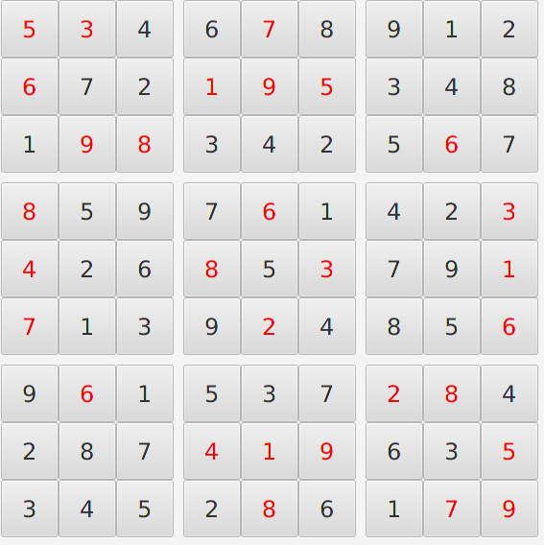
Solving the Sudoku
A branch should terminate immediately when it finds an infeasible configuration, and then explore the next branch.
After we have a branch that provides a feasible value to every cell, we have solved our Sudoku!
Unlike many optimization problems, Sudokus are trivial to solve because they constrain their search spaces quickly.

Slide 75
Building a Tree Search Algorithm
You will need to get comfortable with recursive functions!
Sort variables by a good heuristic (e.g. Sudoku cells by their candidate value count)
Start at the first variable, and explore every combination of values for all the other variables in a tree-like fashion.
On each “node”, check to see if the current branch is still feasible and not breaking problem constraints.
If an infeasibility is detected, “prune” and cancel that branch and move onto the next one.
Proceed until a feasible solution is found, then stop the search. If no solution is found, report that no solution exists.
A
B

Slide 76
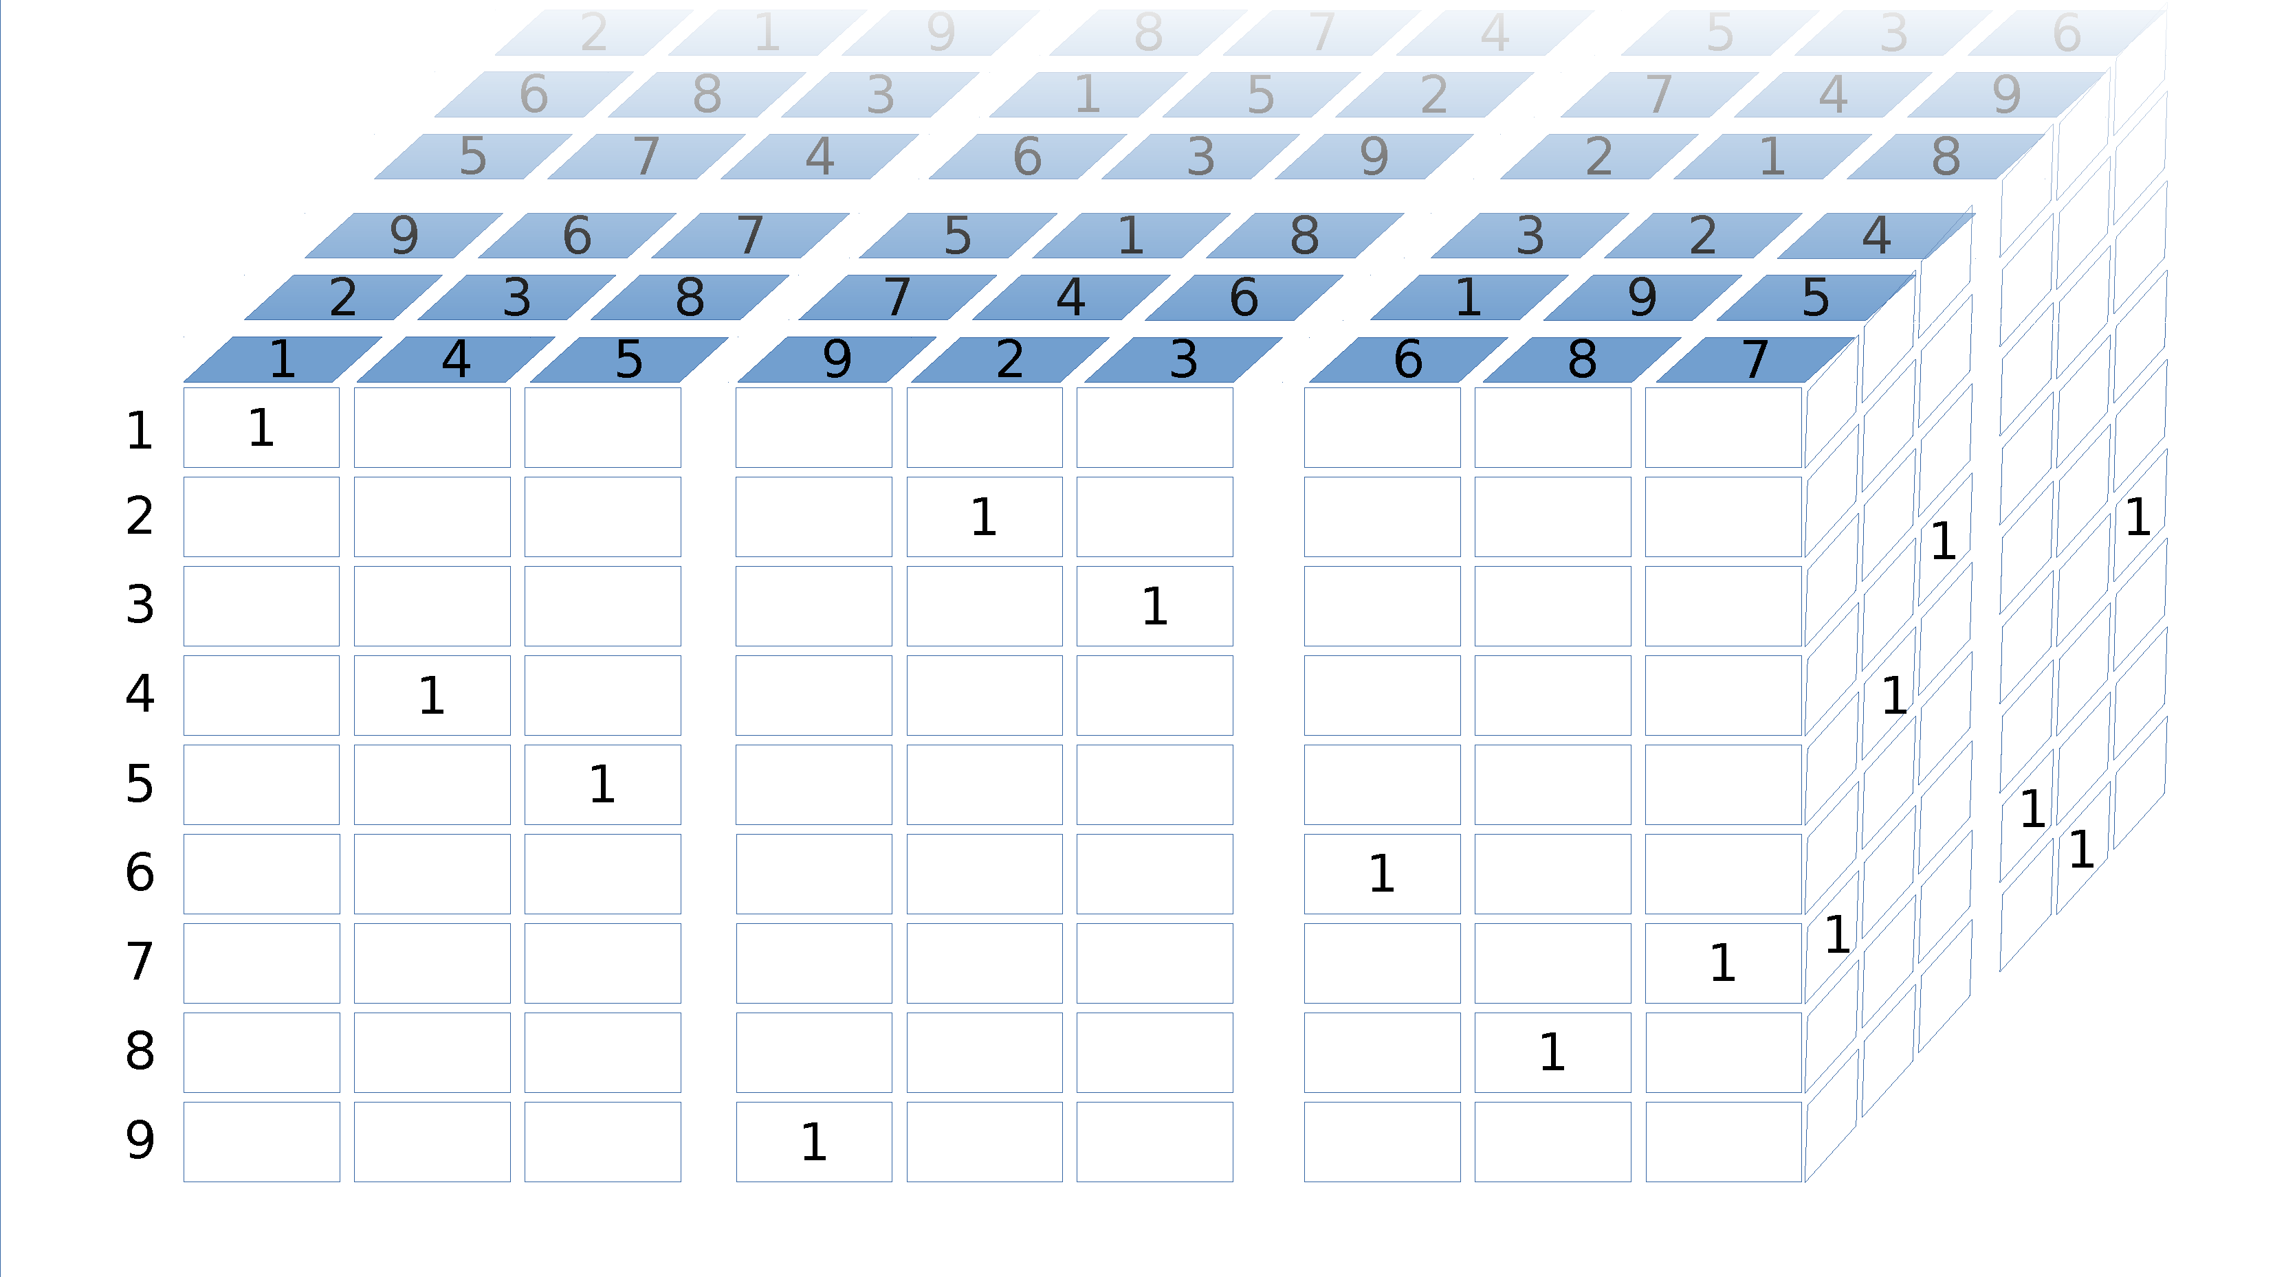
ALTERNATIVE: Binary Model for Sudokus

Slide 77
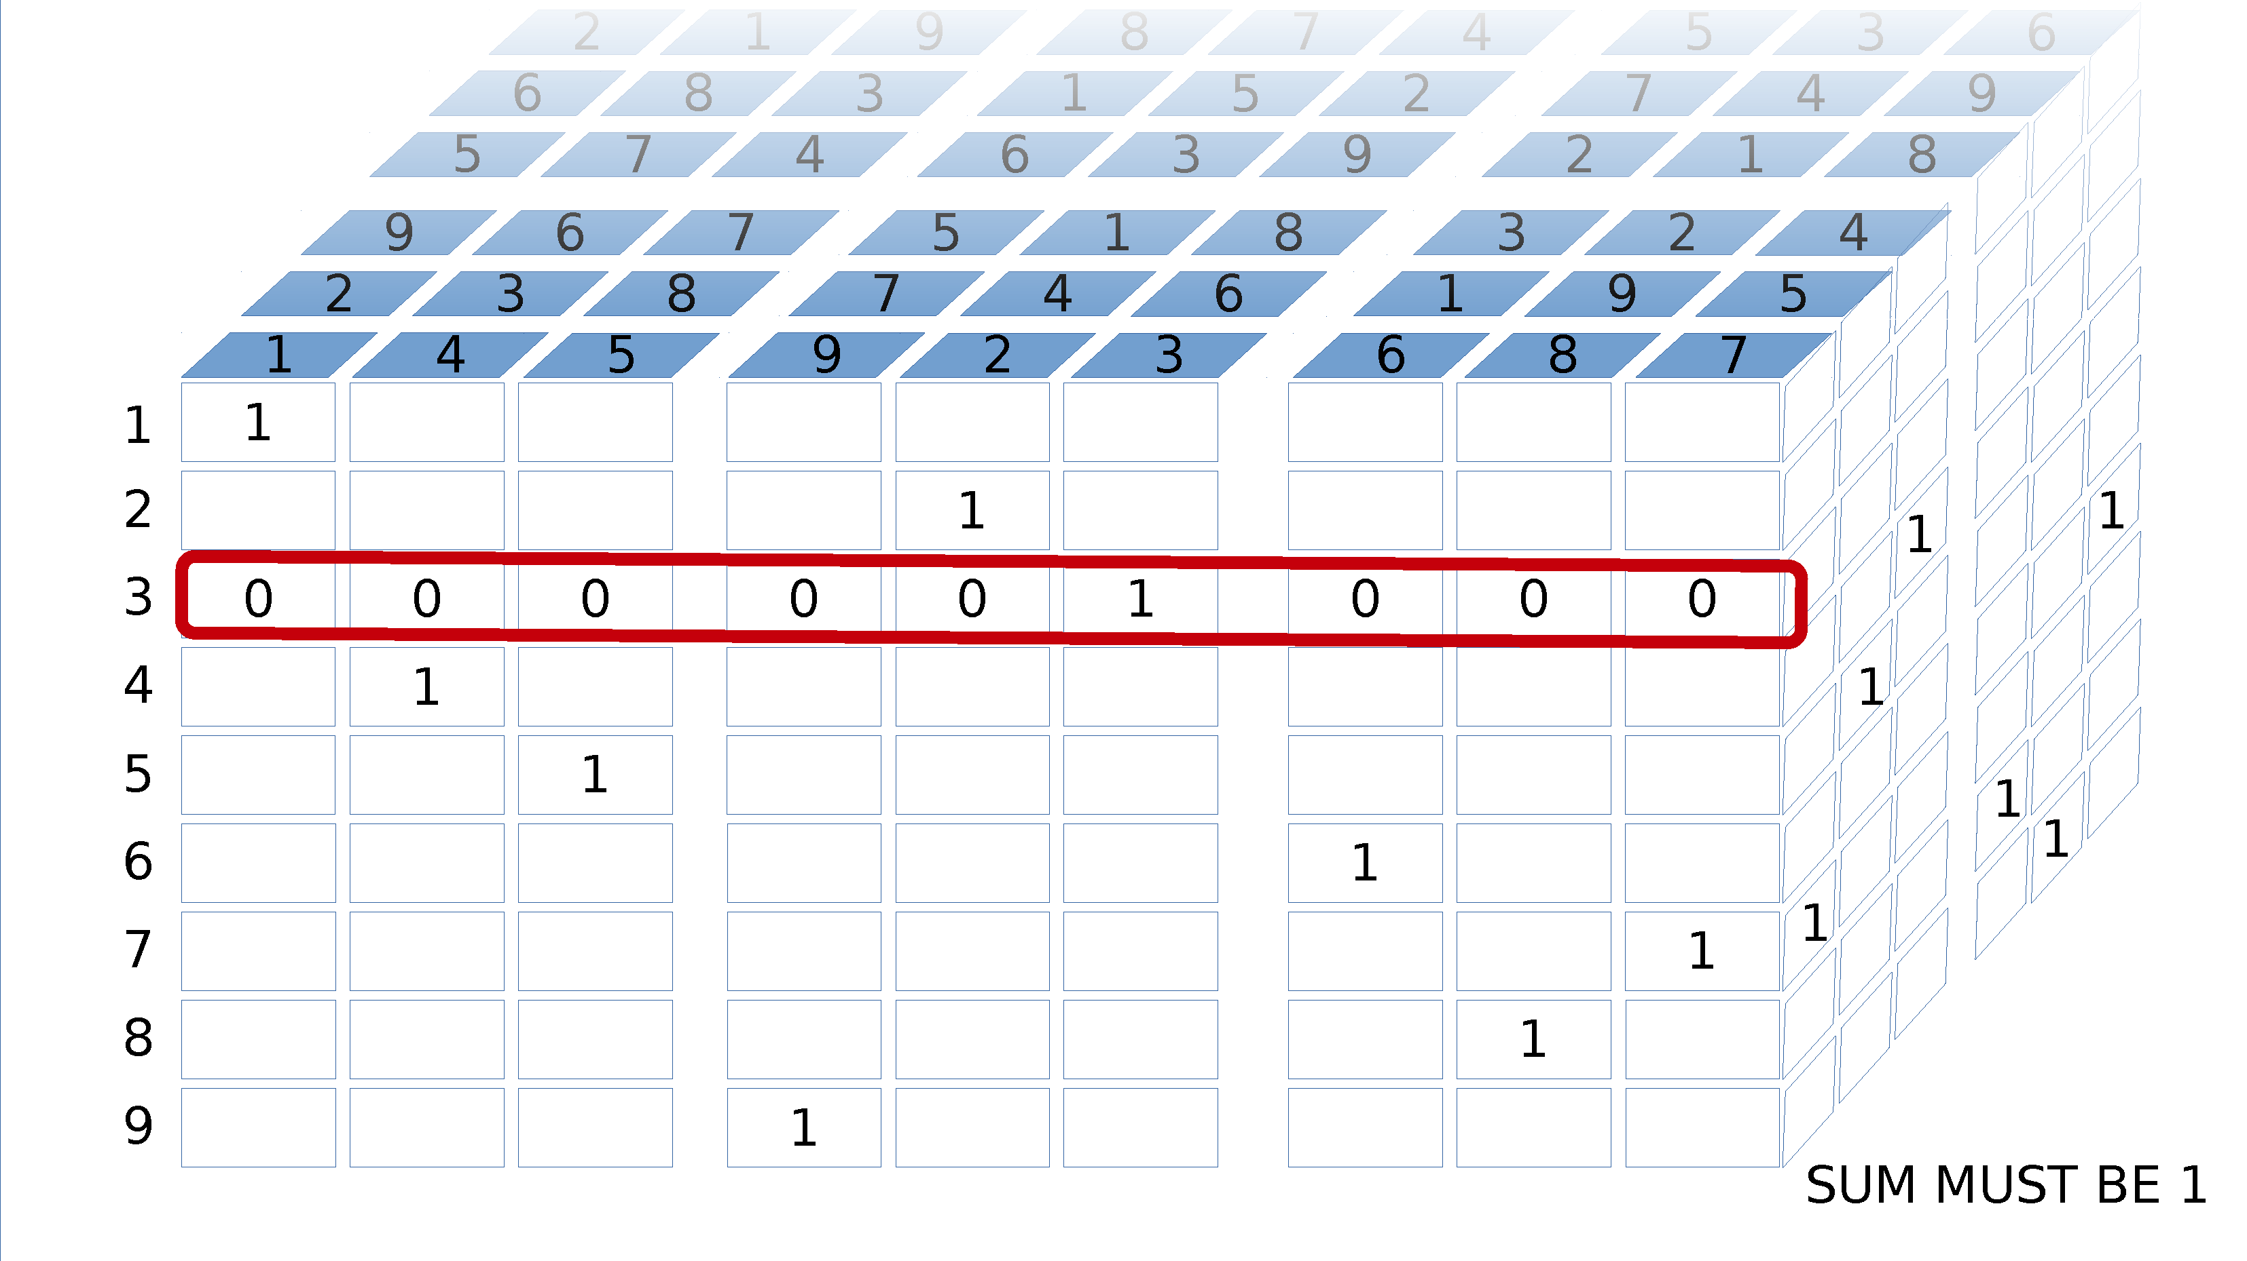
ALTERNATIVE: Binary Model for Sudokus

Slide 78
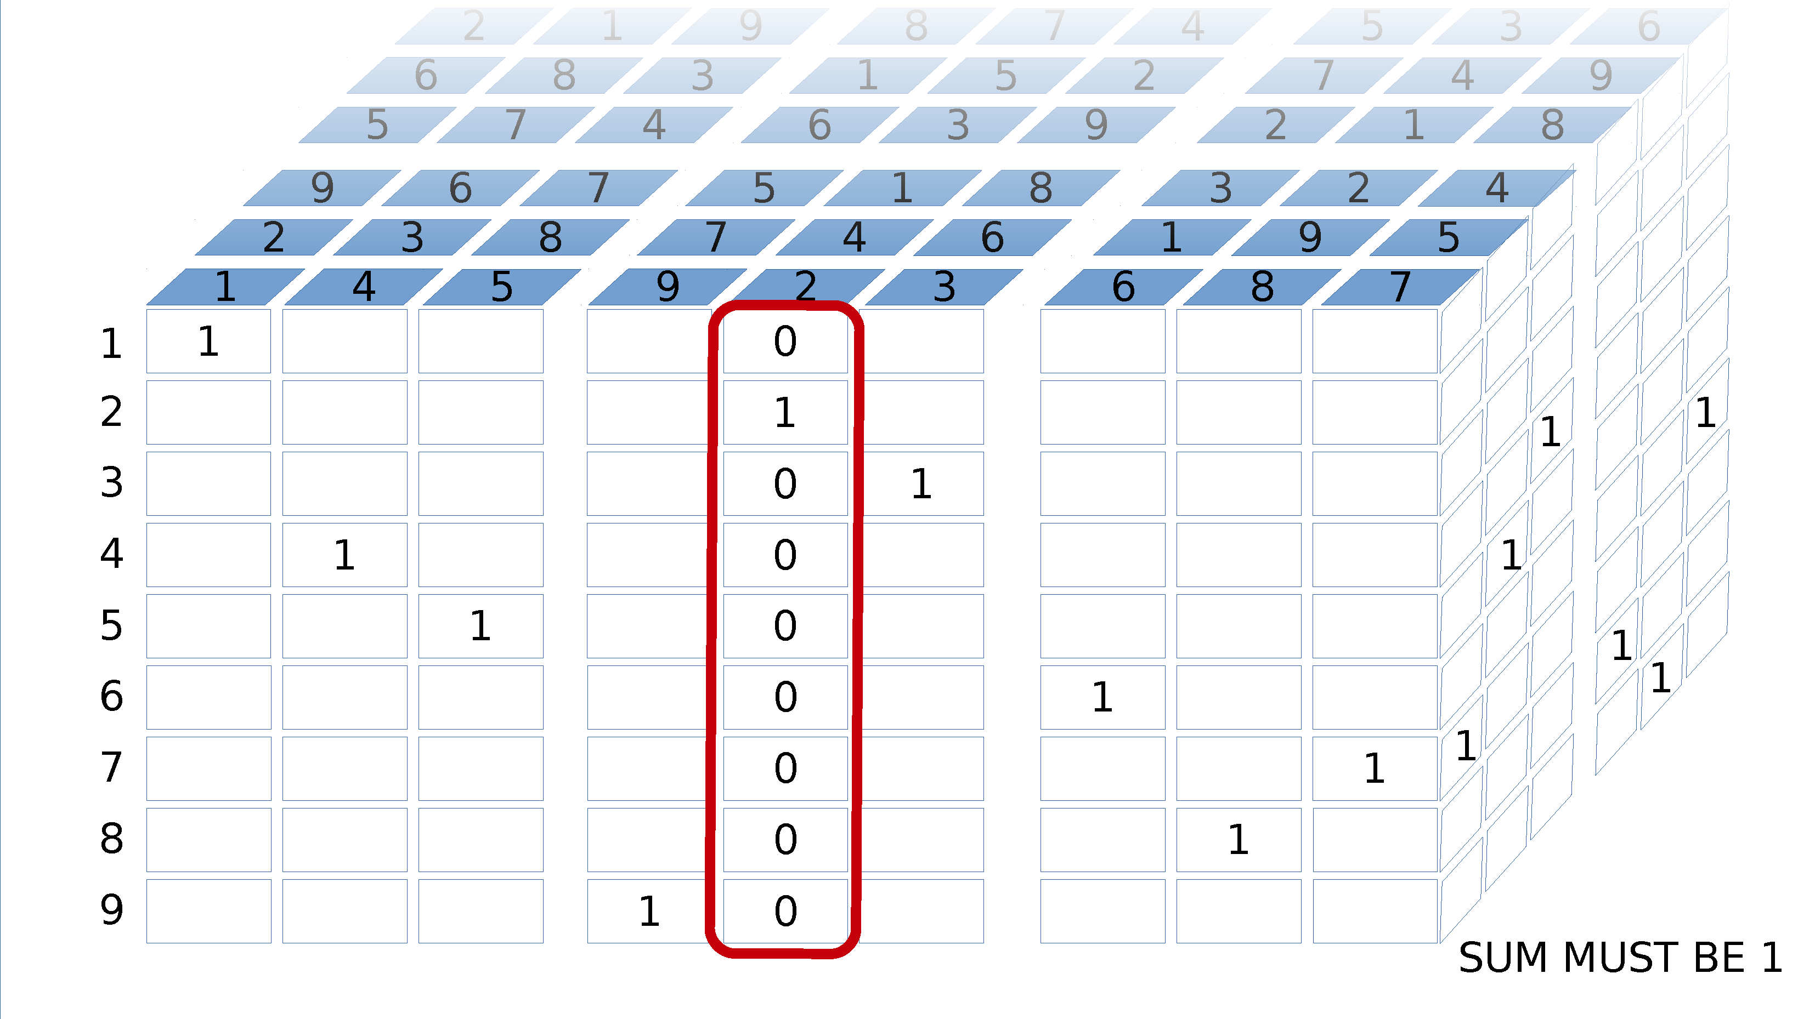
ALTERNATIVE: Binary Model for Sudokus

Slide 79
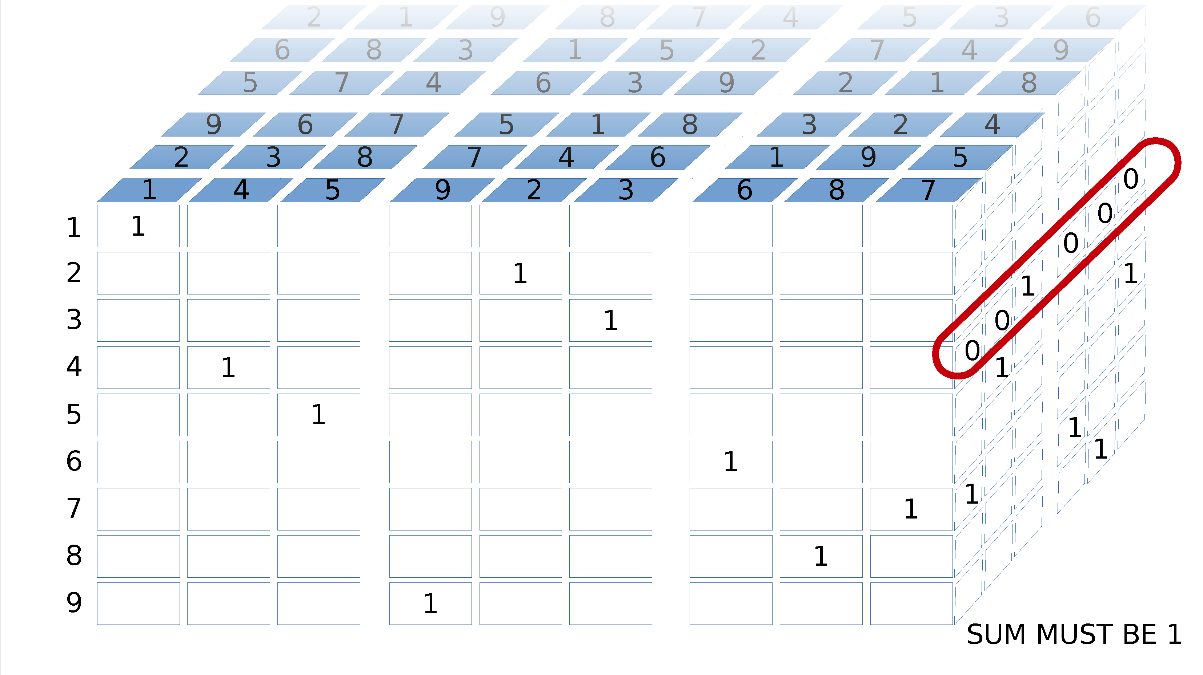
ALTERNATIVE: Binary Model for Sudokus

Slide 80
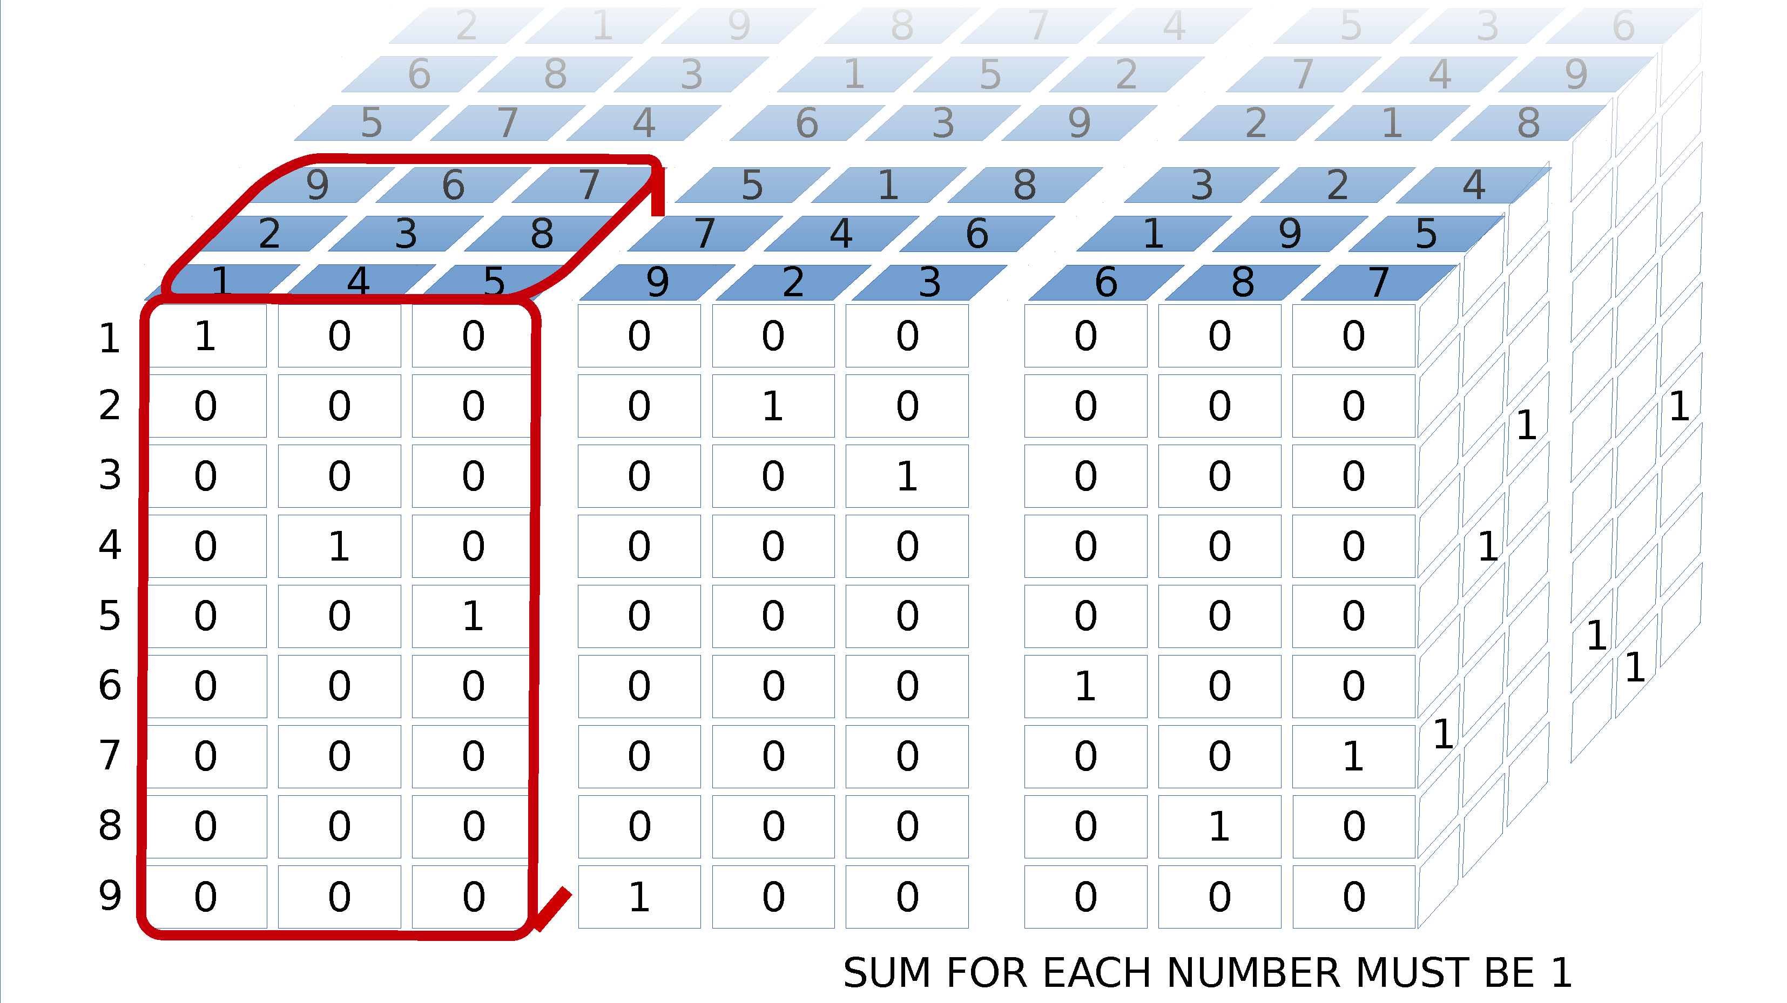
ALTERNATIVE: Binary Model for Sudokus

Slide 81

ALTERNATIVE: Binary Model for Sudokus

Slide 82
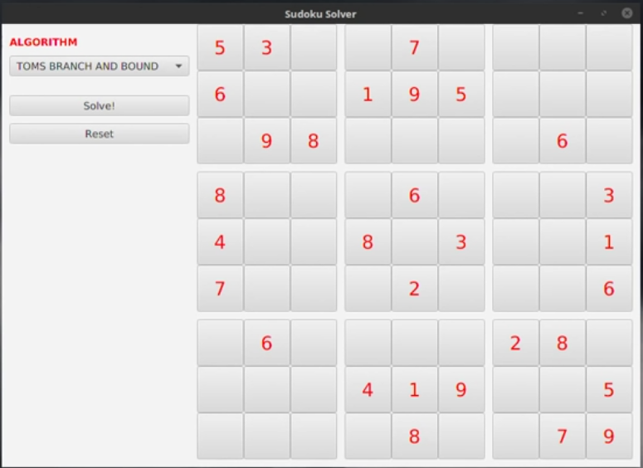
Demo: Solving a Sudoku

Slide 83
Generating a Schedule
You need to generate a schedule for a single classroom with the following classes:
Psych 101 (1 hour, 2 sessions/week)
English 101 (1.5 hours, 2 sessions/week)
Math 300 (1.5 hours, 2 sessions/week)
Psych 300 (3 hours, 1 session/week)
Calculus I (2 hours, 2 sessions/week) Linear Algebra I (2 hours, 3 sessions/week) Sociology 101 (1 hour, 2 sessions/week)
Biology 101 (1 hour, 2 sessions/week)
Supply Chain 300 (2.5 hours, 2 sessions/week)
Orientation 101 (1 hour, 1 session/week)
Available scheduling times are Monday through Friday, 8:00AM-11:30AM, 1:00PM-5:00PM Slots are scheduled in 15 minute increments.

Slide 84
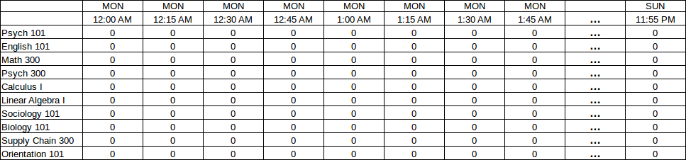
Generating a Schedule
Visualize a grid of each 15-minute increment from Monday through Sunday, intersected with each possible class.
Each cell will be a 1 or 0 indicating whether that’s the start of the first class.

Slide 85
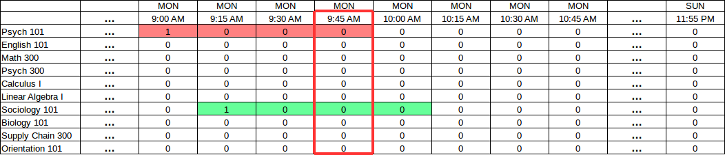
Generating a Schedule
Next visualize how overlaps will occur.
Notice how a 9:00AM Psych 101 class will clash with a 9:15AM Sociology 101.
We can sum all blocks that affect the 9:45AM block and ensure they don’t exceed 1.
Sum of affecting slots = 2 FAIL, sum must be <=1

Slide 86
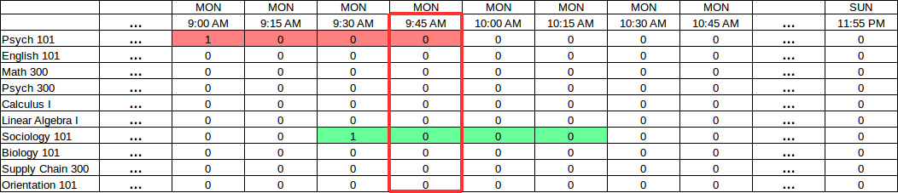
Generating a Schedule
Next visualize how overlaps will occur.
Notice how a 9:00AM Psych 101 class will clash with a 9:30AM Sociology 101.
We can sum all blocks that affect the 9:45AM block and ensure they don’t exceed 1.
Sum of affecting slots = 2 FAIL, sum must be <=1

Slide 87
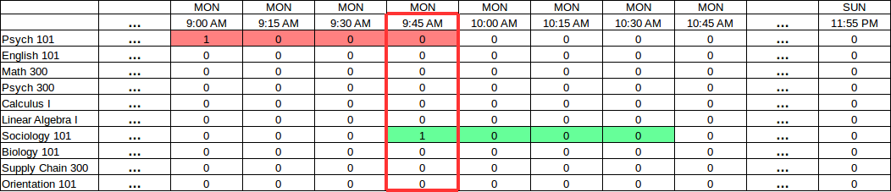
Generating a Schedule
Next visualize how overlaps will occur.
Notice how a 9:00AM Psych 101 class will clash with a 9:45AM Sociology 101.
We can sum all blocks that affect the 9:45AM block and ensure they don’t exceed 1.
Sum of affecting slots = 2 FAIL, sum must be <=1

Slide 88
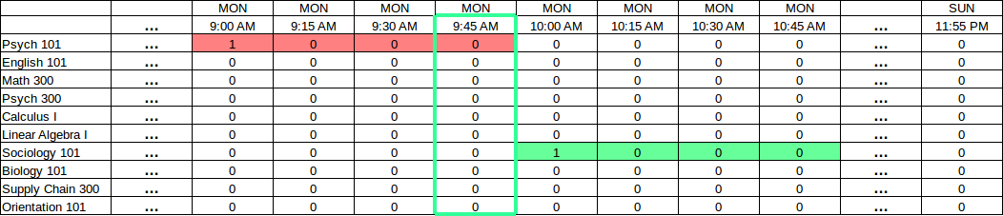
Generating a Schedule
If the “sum” of all slots affecting a given block are no more than 1, then we have no conflicts!
Sum of affecting slots = 1 SUCCESS!

Slide 89
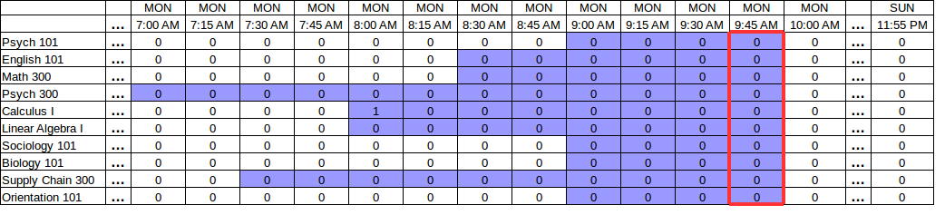
Generating a Schedule
For every “block”, we must sum all affecting slots (shaded below) which can be identified from the class durations.
This sum must be no more than 1.

Slide 90
Generating a Schedule
Taking this concept even further, we can account for all recurrences.
The “affected slots” for a given block can query for all recurrences for each given class.
View image here.

Slide 91
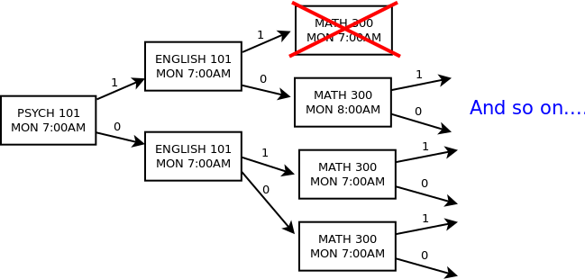
Branch-and-Prune for Scheduling
You could solve the scheduling problem from scratch with branch-and-prune.
Start with the most “constrained” slots first to narrow your search space (e.g. slots fixed to zero first, followed by Monday slots for 3-recurrence classes).
HINT: Proactively prune the tree as you go, eliminating any slots ahead that must be zero due to a “1” decision propagating an occupied state.

Slide 92

Demo: Generating a Classroom Schedule

Slide 93
Generating a Schedule
Plug these variables and feasible constraints into the optimizer or a tree search algorithm (which I’ll show next), and you will get a solution.
Most of the work will be finding the affecting slots for each block.

Slide 94
Generating a Schedule
If you want to schedule against multiple rooms, plot each variable using three dimensions.
MON 8:00
MON 8:15
MON 8:30
MON 8:45
MON 9:00
MON 9:15
MON 9:30
MON 9:45
PSYCH 300
1
0
0
0
MATH 300
PSYCH 101
1
0
0
0
ROOM 1
1
0
0
0
ROOM 2
1
0
0
0
ROOM 3

Slide 95
Linear Relaxation with Branch and Bound
When you are doing a minimization/maximization objective with tree search, you might consider using branch-and-bound to prune your search tree more aggressively.
Say you have a shipping container that has a capacity of 24, and you have the following items you want to ship:
Order A – Requires a capacity of 5, and produces revenue of $10K.
Order B – Requires a capacity of 10, produces revenue of $50K
Order C – Requires a capacity of 3, produces revenue of $30K
Order D – Requires a capacity of 12, produces revenue of $40K
What is the maximum revenue we can achieve with only so much capacity?

Slide 96
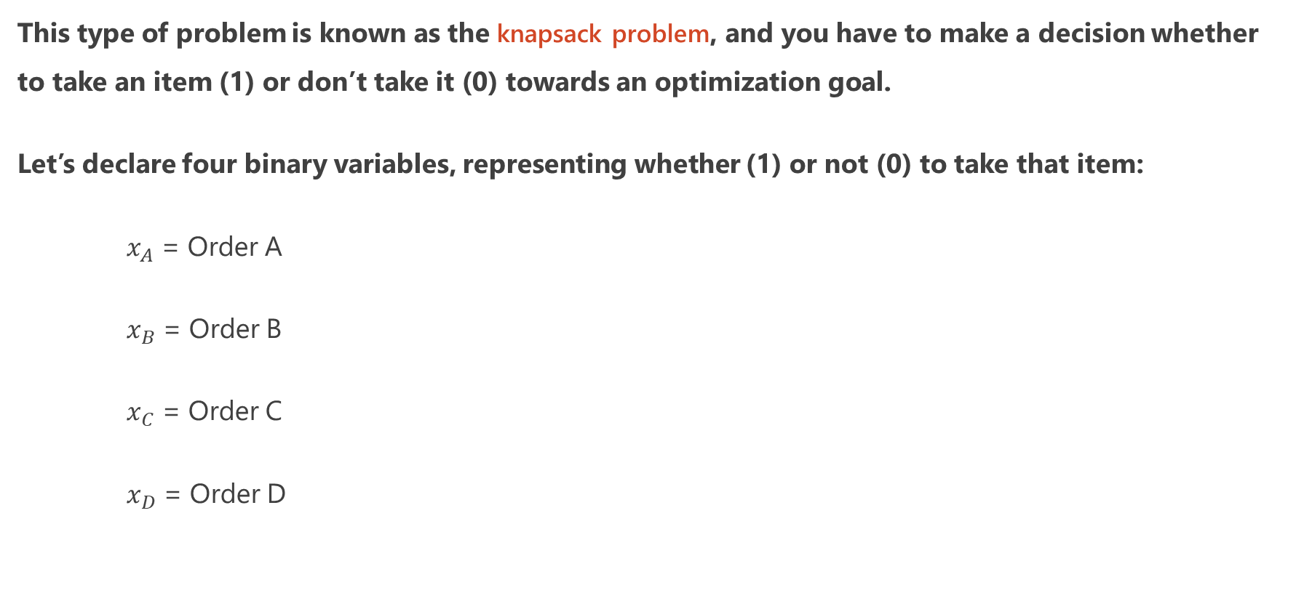
Linear Relaxation with Branch and Bound
This type of problem is known as the knapsack problem, and you have to make a decision whether to take an item (1) or don’t take it (0) towards an optimization goal.
Let’s declare four binary variables, representing whether (1) or not (0) to take that item:
$x_{A}$ = Order A
$x_{B}$ = Order B
$x_{C}$ = Order C
$x_{D}$ = Order D

Slide 97



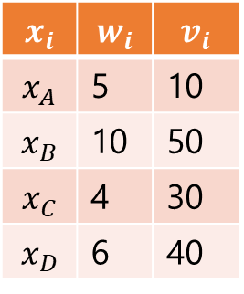
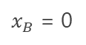
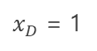

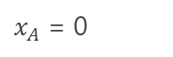
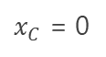
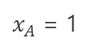
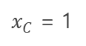
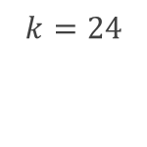
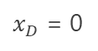
Knapsack Basic Search
$x_{A}$ , $x_{B}, x_{C}, x_{D}$
𝑥_𝐴 , 𝑥_𝐵, 𝑥_𝐶, 𝑥_𝐷
$∑w_{i}=5$
$∑v_{i}=10$
∑𝒘_𝒊=𝟓
∑𝒗_𝒊=𝟏𝟎
$∑w_{i}=15$
$∑v_{i}=60$
∑𝒘_𝒊=𝟏𝟓
∑𝒗_𝒊=𝟔𝟎
$∑w_{i}=19$
$∑v_{i}=90$
∑𝒘_𝒊=𝟏𝟗
∑𝒗_𝒊=𝟗𝟎
$∑w_{i}=0$
$∑v_{i}=0$
∑𝒘_𝒊=𝟎
∑𝒗_𝒊=𝟎
$∑w_{i}=5$
$∑v_{i}=10$
∑𝒘_𝒊=𝟓
∑𝒗_𝒊=𝟏𝟎
$∑w_{i}=15$
$∑v_{i}=60$
∑𝒘_𝒊=𝟏𝟓
∑𝒗_𝒊=𝟔𝟎
$∑w_{i}=9$
$∑v_{i}=40$
∑𝒘_𝒊=𝟗
∑𝒗_𝒊=𝟒𝟎
$∑w_{i}=5$
$∑v_{i}=10$
∑𝒘_𝒊=𝟓
∑𝒗_𝒊=𝟏𝟎
$∑w_{i}=10$
$∑v_{i}=50$
∑𝒘_𝒊=𝟏𝟎
∑𝒗_𝒊=𝟓𝟎
$$And so on…$$
𝑨𝒏𝒅 𝒔𝒐 𝒐𝒏…
$∑w_{i}=25$
$∑v_{i}=130$
∑𝒘_𝒊=𝟐𝟓
∑𝒗_𝒊=𝟏𝟑𝟎
$∑w_{i}=21$
$∑v_{i}=100$
∑𝒘_𝒊=𝟐𝟏
∑𝒗_𝒊=𝟏𝟎𝟎
$∑w_{i}=19$
$∑v_{i}=90$
∑𝒘_𝒊=𝟏𝟗
∑𝒗_𝒊=𝟗𝟎
$∑w_{i}=15$
$∑v_{i}=60$
∑𝒘_𝒊=𝟏𝟓
∑𝒗_𝒊=𝟔𝟎
$∑w_{i}=15$
$∑v_{i}=80$
∑𝒘_𝒊=𝟏𝟓
∑𝒗_𝒊=𝟖𝟎
$∑w_{i}=9$
$∑v_{i}=40$
∑𝒘_𝒊=9
∑𝒗_𝒊=40
$∑w_{i}=11$
$∑v_{i}=50$
∑𝒘_𝒊=𝟏𝟏
∑𝒗_𝒊=𝟓𝟎
$∑w_{i}=5$
$∑v_{i}=10$
∑𝒘_𝒊=𝟓
∑𝒗_𝒊=𝟏𝟎
$$And so on…$$
𝑨𝒏𝒅 𝒔𝒐 𝒐𝒏…
$$x_{i}$$ | $$w_{i}$$ | $$v_{i}$$
$$x_{A}$$ | 5 | 10
$$x_{B}$$ | 10 | 50
$$x_{C}$$ | 4 | 30
$$x_{D}$$ | 6 | 40
$$k=24$$
$x_{A}$ = 1
$x_{A}$ = 0
$x_{B}$ = 1
$x_{B}$ = 0
$x_{B}$ = 1
$x_{B}$ = 0
$x_{C}$ = 1
$x_{C}$ = 0
$x_{C}$ = 1
$x_{C}$ = 0
$x_{D}$ = 1
$x_{D}$ = 0
$x_{D}$ = 1
$x_{D}$ = 0
$x_{D}$ = 1
$x_{D}$ = 0
$x_{D}$ = 1
$x_{D}$ = 0

Slide 98
Knapsack Basic Search
$x_{A}$ , $x_{B}, x_{C}, x_{D}$
𝑥_𝐴 , 𝑥_𝐵, 𝑥_𝐶, 𝑥_𝐷
$∑w_{i}=5$
$∑v_{i}=10$
∑𝒘_𝒊=𝟓
∑𝒗_𝒊=𝟏𝟎
$∑w_{i}=15$
$∑v_{i}=60$
∑𝒘_𝒊=𝟏𝟓
∑𝒗_𝒊=𝟔𝟎
$∑w_{i}=19$
$∑v_{i}=90$
∑𝒘_𝒊=𝟏𝟗
∑𝒗_𝒊=𝟗𝟎
$∑w_{i}=0$
$∑v_{i}=0$
∑𝒘_𝒊=𝟎
∑𝒗_𝒊=𝟎
$∑w_{i}=5$
$∑v_{i}=10$
∑𝒘_𝒊=𝟓
∑𝒗_𝒊=𝟏𝟎
$∑w_{i}=15$
$∑v_{i}=60$
∑𝒘_𝒊=𝟏𝟓
∑𝒗_𝒊=𝟔𝟎
$∑w_{i}=9$
$∑v_{i}=40$
∑𝒘_𝒊=𝟗
∑𝒗_𝒊=𝟒𝟎
$∑w_{i}=5$
$∑v_{i}=10$
∑𝒘_𝒊=𝟓
∑𝒗_𝒊=𝟏𝟎
$∑w_{i}=10$
$∑v_{i}=50$
∑𝒘_𝒊=𝟏𝟎
∑𝒗_𝒊=𝟓𝟎
$$And so on…$$
𝑨𝒏𝒅 𝒔𝒐 𝒐𝒏…
$∑w_{i}=25$
$∑v_{i}=130$
∑𝒘_𝒊=𝟐𝟓
∑𝒗_𝒊=𝟏𝟑𝟎
$∑w_{i}=21$
$∑v_{i}=100$
∑𝒘_𝒊=𝟐𝟏
∑𝒗_𝒊=𝟏𝟎𝟎
$∑w_{i}=19$
$∑v_{i}=90$
∑𝒘_𝒊=𝟏𝟗
∑𝒗_𝒊=𝟗𝟎
$∑w_{i}=15$
$∑v_{i}=60$
∑𝒘_𝒊=𝟏𝟓
∑𝒗_𝒊=𝟔𝟎
$∑w_{i}=15$
$∑v_{i}=80$
∑𝒘_𝒊=𝟏𝟓
∑𝒗_𝒊=𝟖𝟎
$∑w_{i}=9$
$∑v_{i}=40$
∑𝒘_𝒊=9
∑𝒗_𝒊=40
$∑w_{i}=11$
$∑v_{i}=50$
∑𝒘_𝒊=𝟏𝟏
∑𝒗_𝒊=𝟓𝟎
$∑w_{i}=5$
$∑v_{i}=10$
∑𝒘_𝒊=𝟓
∑𝒗_𝒊=𝟏𝟎
$$And so on…$$
𝑨𝒏𝒅 𝒔𝒐 𝒐𝒏…
$$x_{i}$$ | $$w_{i}$$ | $$v_{i}$$
$$x_{A}$$ | 5 | 10
$$x_{B}$$ | 10 | 50
$$x_{C}$$ | 4 | 30
$$x_{D}$$ | 6 | 40
$$k=24$$
This is so inefficient. We found a solution and then keep exploring bad solutions. Is there a way to prune and avoid all this?
$$k=24$$
$x_{A}$ = 1
$x_{A}$ = 0
$x_{B}$ = 1
$x_{B}$ = 0
$x_{B}$ = 1
$x_{B}$ = 0
$x_{C}$ = 1
$x_{C}$ = 0
$x_{C}$ = 1
$x_{C}$ = 0
$x_{D}$ = 1
$x_{D}$ = 0
$x_{D}$ = 1
$x_{D}$ = 0
$x_{D}$ = 1
$x_{D}$ = 0
$x_{D}$ = 1
$x_{D}$ = 0

Slide 99
Linear Relaxation with Branch and Bound
Yes! We can prune our search tree further with linear relaxation, a.k.a. bounding.
Bounding means we calculate the minimum achievable value at each node, and prune branches where that value is inferior to the best found value.
To implement, let’s first use a heuristic that ratios the value to weight of each item, and sorts them starting with highest value items first.
Item | Weight | Value (in thousands $) | Value/Weight Ratio
Order C | 4 | $30 | $30/4 = $7.50
Order D | 6 | $40 | $40/6 = $6.66
Order B | 10 | $50 | $50/10 = $5
Order A | 5 | $10 | $10/5 = $2

Slide 100

Linear Relaxation with Branch and Bound
Next, let’s see how many items we can fit with our capacity of 24, starting with the highest value/weight ratio item first.
Then we take a fraction of the last item that exceeds the capacity so it matches capacity, and multiply that fraction against that item’s value to get a relaxed achievable value.
Item | Weight | Value (in thousands $) | Value/Weight Ratio | Relaxed Weight | Relaxed Value
Order C | 4 | $30 | $30/4 = $7.50 | 4 | $30
Order D | 6 | $40 | $40/6 = $6.66 | 4 + 6 = 10 | $30 + $40 = $70
Order B | 10 | $50 | $50/10 = $5 | 4 + 6 + 10 = 20 | $30 + $40 + $50 = $120
Order A | 5 | $10 | $10/5 = $2 | 4 + 6 + 10 + 5 = 25 4 + 6 + 10 + (24-20) = 24 | $30 + $40 + $50 + $10 = $130 $30 + $40 + $50 + $\left(\frac{24−20}{5}\right)$($10) = $128
This is the max we can ever achieve

Slide 101








Knapsack Branch-and-Bound Search
$x_{A}$ , $x_{B}, x_{C}, x_{D}$
𝑥_𝐴 , 𝑥_𝐵, 𝑥_𝐶, 𝑥_𝐷
$∑w_{i}=4$
$$∑v_{i}=30$$
Achievable=128
∑𝒘_𝒊=𝟒
∑𝒗_𝒊=𝟑𝟎
Achievable=128
$∑w_{i}=10$
$$∑v_{i}=70$$
Achievable=128
∑𝒘_𝒊=𝟏𝟎
∑𝒗_𝒊=𝟕𝟎
Achievable=128
$∑w_{i}=20$
$$∑v_{i}=120$$
Achievable=128
∑𝒘_𝒊=𝟐𝟎
∑𝒗_𝒊=𝟏𝟐𝟎
Achievable=128
$∑w_{i}=0$
$$∑v_{i}=0$$
Achievable=100
∑𝒘_𝒊=𝟎
∑𝒗_𝒊=𝟎
Achievable=100
$$∑w_{i}=4$$
$$∑v_{i}=30$$
Achievable=90
∑𝒘_𝒊=𝟒
∑𝒗_𝒊=𝟑𝟎
Achievable=90
$$∑w_{i}=10$$
$$∑v_{i}=70$$
Achievable=80
∑𝒘_𝒊=𝟏𝟎
∑𝒗_𝒊=𝟕𝟎
Achievable=80
$∑w_{i}=25$
$$∑v_{i}=130$$
∑𝒘_𝒊=𝟐𝟓
∑𝒗_𝒊=𝟏𝟑𝟎
$∑w_{i}=20$
$$∑v_{i}=120$$
∑𝒘_𝒊=𝟐𝟎
∑𝒗_𝒊=𝟏𝟐𝟎
Finally, let’s create a new search tree exploring items in this heuristic order.
Along the way, we will calculate the relaxed bounded value at each node to see what is achievable. If that value is inferior the best solution found, we prune and terminate that branch.
Using this technique, look how much more efficiently our search turned out on the right!
$$x_{i}$$ | $$w_{i}$$ | $$v_{i}$$ | $w_{i}$/$v_{i}$
$$x_{C}$$ | 4 | 30 | 7.50
$$x_{D}$$ | 6 | 40 | 6.66
$$x_{B}$$ | 10 | 50 | 5
$$x_{A}$$ | 5 | 10 | 2
$$k=24$$
$x_{C}$ = 1
$x_{C}$ = 0
$x_{D}$ = 1
$x_{D}$ = 0
$x_{B}$ = 1
$x_{B}$ = 0
$x_{A}$ = 1
$x_{A}$ = 0

Slide 102
Solving with PuLP
You can create this branch-and-bound search tree from scratch, but most people will use libraries like PuLP, PyOmo, or ojAlgo.
The Python code to the right solves this knapsack problem using PuLP.
These libraries also allow dropping in licensed solvers that can improve performance for larger problems, like Gurobi or IBM’s CPLEX which costs over $10K.
Keep in mind these solvers are largely limited to linear problems, so no exponential constraints, sine functions, etc!
We will learn more about linear programming in the next section.
from pulp import * # declare your variables x_a = LpVariable("x_a", cat=LpBinary) x_b = LpVariable("x_b", cat=LpBinary) x_c = LpVariable("x_c", cat=LpBinary) x_d = LpVariable("x_d", cat=LpBinary) # defines the problem prob = LpProblem("Knapsack Problem", LpMaximize) # defines the weight constraint where items can't exceed 24 prob += 5*x_a + 10*x_b + 4*x_c + 6*x_d <= 24 # defines the objective function to maximize prob += 10*x_a + 50*x_b + 30*x_c + 40*x_d # solve the problem status = prob.solve() print(LpStatus[status]) # print the results x_a=0.0, x_b=1.0, x_c=1.0, x_d=1.0 print(value(x_a)) print(value(x_b)) print(value(x_c)) print(value(x_d))

Slide 103
Pros and Cons of Tree Search
Pros | Cons
Precise, deterministic, and consistent Does a thorough search while avoiding infeasible search space Relatively easy to reason with and explain to others, even non-technical people Flexible and adaptable to many discrete problems, supporting a wide array of constraints and optimization objectives | Can be really slow if applied to improperly pruned or extremely large problems, heuristic and bounding is often necessary to prune search space feasibly. Not necessarily designed for problems with continuous variables (unless you use decision trees/random forests-like paradigms)

Slide 104

The Many Applications of Search Trees
Tree search algorithms are used heavily in many areas of applied mathematics and “artificial intelligence”.
Permutations and combinations
Minimax (used for Chess, game theory)
Alpha-Beta Pruning (for Chess, adversarial search)
Branch-and-bound algorithms
Mixed Integer Programming
The breakthrough “MAC Hack VI” chess program in 1965.

Slide 105
Quiz Time!
Branch and Bound algorithms will guarantee an optimal solution.
True
False
A
B

Slide 106
Quiz Time!
Branch and Bound algorithms will guarantee an optimal solution.
True
False
A
B
Unlike stochastic (random) algorithms, search trees usually cover an entire search space while pruning obvious infeasible/inferior solutions, and ultimately will find the optimal solution given enough time and correct heuristics.

Slide 107


Quiz Time!
You have 175 late shipments and you need to prioritize which ones to put on a truck. Your boss says to prioritize by shipping the most delayed orders first, but take into account the size of the orders too.
Which heuristic should you likely sort your items in your tree search?
Sort on $\frac{\# days delay}{weight}, starting with the highest first$
Sort on $\frac{\# days delay}{weight}, starting with the lowest first$
Sort on # days delay, starting with the highest first
A
This Photo by Unknown Author is licensed under CC BY-SA
B
C

Slide 108

Quiz Time!
You have 175 late shipments and you need to prioritize which ones to put on a truck. Your boss says to prioritize by shipping the most delayed orders first, but take into account the size of the orders too.
Which heuristic should you likely sort your items in your tree search?
Sort on $\frac{\# days delay}{weight}, starting with the highest first$
Sort on $\frac{\# days delay}{weight}, starting with the lowest first$
Sort on # days delay, starting with the highest first
A
This Photo by Unknown Author is licensed under CC BY-SA
B
Think of “lateness” as the currency driving value for each shipment. To effectively do a branching search, we need to sort the items by a ratio dividing their value (lateness) by the weight. This will guide the heuristic to select the most critical items first.
C

Slide 109
Section IV Linear Programming

Slide 110

What Is Linear Programming?
Linear Programming is the workhorse of operations research algorithms, and models variables, objectives, and constraints as linear relationships
LP models convert a problem into a system of linear equations.
Linear algebra techniques will express these variables and constraints in matrix format, and use Gaussian elimination to solve for the variables.
When discrete/integer variables are involved, tree search algorithms can use linear programming to reduce the search space
Linear programming and the simplex method can be quite a rabbit hole, so we will do an intuitive graphical approach and encourage using libraries to do the linear algebra work for you.
https://en.wikipedia.org/wiki/Linear_programming

Slide 111



A Brief History of Linear Programming
Pioneered by Soviet economist Leonid Kantorovich in 1939 to reduce costs of the Soviet Army.
Further developed by T.C. Koopman (Dutch American) and Frank Lauren Hitchcock (American).
The Simplex Method was then invented by George B. Dantzig in 1947 for the U.S. Air Force, and this is the breakthrough algorithm used today.
Leonid Kantorovich
George B. Dantzig
George B. Dantzig being awarded National Medal of Science by by U.S. President Gerald Ford in 1976.

Slide 112
Problem 1 – Factory Optimization
You have two lines of products: the iPac and iPac Ultra.
The iPac makes $200 of profit while the iPac Ultra makes $300 of profit.
However, the assembly line can only work for 20 hours, and it takes 1 hour to produce the iPac and 3 hours to produce an iPac Ultra.
Only 45 kits can be provided in a day, and an iPac requires 6 kits while iPac Ultra requires 2 kits.
Assuming all supply will be sold, how many of the iPac and iPac Ultra should we sell to maximize profit?

Slide 113


Problem 1 – Factory Optimization
First Constraint:
“A single assembly line can only work for 20 hours, and it takes 1 hour to produce the iPac and 3 hours to produce an iPac Ultra.”
$$x+3y≤20 (x≥0, y≥0)$$

Slide 114


Problem 1 – Factory Optimization
Second Constraint:
“Only 45 kits can be provided in a day, and an iPac requires 6 kits while iPac Ultra requires 2 kits. “
$$6x+2y≤45 (x≥0, y≥0)$$

Slide 115

Problem 1 – Factory Optimization
The region where all the constraints overlap is the feasible region.
At one of the corners (called vertices) is the solution.

Slide 116


Problem 1 – Factory Optimization
“The iPac makes $200 of profit while the iPac Ultra makes $300 of profit.“
The objective function (profit) is defined by:
$$Z=200x+300y$$
Since this is a maximization problem, we will increase Z and move the objective line upwards and the last convex it touches is the solution.
https://www.desmos.com/calculator/iildqi2vt7

Slide 117


Problem 1 – Factory Optimization
“The iPac makes $200 of profit while the iPac Ultra makes $300 of profit.“
The objective function (profit) is defined by:
$$Z=200x+300y$$
Since this is a maximization problem, we will increase Z and move the objective line upwards and the last convex it touches is the solution.
On the next slide, we will see how to solve this using Python PuLP.
(5.9375,4.6875)
https://www.desmos.com/calculator/iildqi2vt7

Slide 118

Problem 1 – Factory Optimization
But do we really want continuous?
A fraction of a product may not make sense!
(5.9375,4.6875)

Slide 119


Problem 1 – Factory Optimization (Integer Version)
That’s better! Solve with integers.
But there’s a cost
(5,5)
https://www.desmos.com/calculator/vu6gxi1tgn

Slide 120
Linear versus Integer Programming
Linear programming via the Simplex algorithm is usually quite lean, and does some matrix work (called the tableau) to find a solution.
However, as shown in our last example, we do not always want our variables to be continuous but rather discrete integers.
This has a steep cost because our solver now has to use a tree search algorithm to traverse a search space.
For this reason, you may consider using linear programming and just rounding the result.
But if integer-based solutions are critical, linear programming can still be leveraged to reduce the search space and guide it towards the solution (using techniques like polyhedral cutting, bounding, etc.)

Slide 121

Linear versus Integer Programming
If you are comfortable with linear algebra, then doing linear/integer programming from scratch can be quite rewarding.
However linear programming, the simplex algorithm, and cutting-plane methods are a bit involved.
Unless you are super comfortable with linear algebra, just stick with using libraries like PuLP, PyOmo, and ojAlgo.

Slide 122

Problem 2: Minimization
You need at least 50 oz of oil.
It costs $3/oz for oil from Supplier A, and $1/oz from Supplier B.
An ounce of Supplier A takes 1 unit of storage and Supplier B takes 2 units of storage. You only have 120 units of storage.
To maintain quality, you need at least 1oz of Supplier A oil per 2oz of Supplier B oil.
How much of Supplier A and Supplier B oil should we buy to minimize cost?

Slide 123


Problem 2: Minimization
You need at least 50 oz of oil.
$$x+y≥50$$
It costs $3/oz for oil from Supplier A, and $1/oz from Supplier B.
$$3x+y=Z$$
An ounce of Supplier A takes 1 unit of storage and Supplier B takes 2 units of storage. You only have 120 units of storage.
$$1x+2y≤120$$
To maintain quality, you need at least 1oz of Supplier A oil per 2oz of Supplier B oil.
$$x≥2y$$
How much of Supplier A and Supplier B oil should we buy to minimize cost?
Since we are minimizing, move the objective line so that Z decreases until we hit the last convex point.
https://www.desmos.com/calculator/jxjytnpad3

Slide 124

Problem 2: Minimization
ANSWER:
x=33.333333
y=16.666667
from pulp import * x = LpVariable("x", lowBound=0, cat=LpContinuous) y = LpVariable("y", lowBound=0, cat=LpContinuous) # Defines the problem prob = LpProblem("Oil Supplier Problem", LpMinimize) # Objective prob += 3*x + y # Constraints prob += x + 2*y <= 120 prob += x + y >= 50 prob += x >= 2*y # Solve! status = prob.solve() print(LpStatus[status]) print(value(x)) # 33.333333 print(value(y)) # 16.666667
Since we are minimizing, move the objective line so that Z decreases until we hit the last convex point.
https://www.desmos.com/calculator/jxjytnpad3

Slide 125

Problem 3 – Portfolio Optimization
You have $100,000 to put into 5 investment opportunities:
Find the right mix of investments to maximize projected return for the entire portfolio, while respecting these constraints:
Stocks cannot account for more than 60% of total investment
No single stock investment can exceed 40% of total stock investment
Real estate investment must be at least 50% of the amount invested in stocks
Unconventional investment cannot exceed 15% of total investment
Investment | Projected Return
Stock A | 15%
Stock B | 10%
Stock C | 20%
Real Estate | 10%
Unconventional | 40%

Slide 126


Problem 3 – Portfolio Optimization
You have $100,000 to put into 5 investment opportunities:
Find the right mix of investments to maximize projected return for the entire portfolio, while respecting these constraints:
Stocks cannot account for more than 60% of total investment: $x_{1}+x_{2}+x_{3}≤(.60)(100,000)$
No single stock investment can exceed 40% of total stock investment: .40($x_{1}+x_{2}+x_{3})≤$ $x_{1 through 3}$
Real estate investment must be at least 50% of the amount invested in stocks: ${(.50)(x}_{1}+ x_{2}+x_{3})≤$ $x_{4}$
Unconventional investment cannot exceed 15% of total investment: $\left(.15\right)\left(100,000\right)>= x_{5}$
Investment | Projected Return | Variable
Stock A | 15% | $$x_{1}$$
Stock B | 10% | $$x_{2}$$
Stock C | 20% | $$x_{3}$$
Real Estate | 10% | $$x_{4}$$
Unconventional | 40% | $$x_{5}$$

Slide 127

Problem 3 – Portfolio Optimization
from pulp import * # declare your variables x_1 = LpVariable("x_1", lowBound=0, cat=LpContinuous) x_2 = LpVariable("x_2", lowBound=0, cat=LpContinuous) x_3 = LpVariable("x_3", lowBound=0, cat=LpContinuous) x_4 = LpVariable("x_4", lowBound=0, cat=LpContinuous) x_5 = LpVariable("x_5", lowBound=0, cat=LpContinuous) # defines the problem prob = LpProblem("Portfolio Problem", LpMaximize) # total investment must be 100,000 prob += x_1 + x_2 + x_3 + x_4 + x_5 == 100000 # No single stock can be more than 40% of all stock investment prob += x_1 <= .40*(x_1 + x_2 + x_3) prob += x_2 <= .40*(x_1 + x_2 + x_3) prob += x_3 <= .40*(x_1 + x_2 + x_3) # stock investments cannot exceed 60% of total investment prob += x_1 + x_2 + x_3 <= (.60 * 100000) # Real estate must be at least 50% of the amount invested in stocks prob += .5*(x_1 + x_2 + x_3) <= x_4 # Unconventional investment cannot exceed 15% of total investment prob += (.15 * 100000) >= x_5 # defines the objective function to maximize prob += .15*x_1 + .10*x_2 + .20*x_3 + .10*x_4 + .40*x_5 # solve the problem status = prob.solve() print(LpStatus[status]) # print the results print(value(x_1)) print(value(x_2)) print(value(x_3)) print(value(x_4))
print(value(x_5))
To the right is how we use Python PuLP to solve this portfolio problem.
We should get the following results:
$x_{1}=$22666.667
$x_{2}=$11333.333
$x_{3}=$22666.667
$x_{4}=$28333.333
$x_{5}=$15000.0

Slide 128
Problem 4 – Mixed Integer Problem
You have three drivers who charge the following rates:
Driver 1: $10 / hr Driver 2: $12 / hr Driver 3: $15 / hr
From 6:00 to 22:00, schedule one driver at a time to provide coverage, and minimize cost.
Each driver must work 4-6 hours a day. Driver 2 cannot work after 11:00.

Slide 129



Stay Calm
Variables and Constants
Constraints
Minimize

Slide 130
Problem 4 – Mixed Integer Problem
from pulp import * # Declare your variables s_1 = LpVariable("s_1", lowBound=6, upBound=22, cat=LpContinuous) e_1 = LpVariable("e_1", lowBound=6, upBound=22, cat=LpContinuous) s_2 = LpVariable("s_2", lowBound=6, upBound=22, cat=LpContinuous) e_2 = LpVariable("e_2", lowBound=6, upBound=22, cat=LpContinuous) s_3 = LpVariable("s_3", lowBound=6, upBound=22, cat=LpContinuous) e_3 = LpVariable("e_3", lowBound=6, upBound=22, cat=LpContinuous) # Defines the problem prob = LpProblem("Driver Shift Problem", LpMinimize) # Objective prob += 10*(e_1-s_1) + 12*(e_2-s_2) + 15*(e_3-s_3) # Keep each driver between 4 and 6 hours prob += 4 <= e_1 - s_1 <= 6 prob += 4 <= e_2 - s_2 <= 6 prob += 4 <= e_3 - s_3 <= 6 # Sum of all shifts must be 16 prob += (e_1 - s_1) + (e_2 - s_2) + (e_3 - s_3) == 16 # Driver 2 must be done by 11am prob += e_2 <= 11 # Prevent Overlaps b_12 = LpVariable("b_12", cat=LpBinary) prob += s_1 >= e_2 - 24*b_12 prob += s_2 >= e_1 - 24*(1-b_12) b_23 = LpVariable("b_23", cat=LpBinary) prob += s_2 >= e_3 - 24*b_23 prob += s_3 >= e_2 - 24*(1-b_23) b_31 = LpVariable("b_31", cat=LpBinary) prob += s_3 >= e_1 - 24*b_31 prob += s_1 >= e_3 - 24*(1-b_31) # Solve! status = prob.solve() print(LpStatus[status]) print("Driver 1: {}-{}".format(value(s_1), value(e_1))) print("Driver 2: {}-{}".format(value(s_2), value(e_2))) print("Driver 3: {}-{}".format(value(s_3), value(e_3)))
Here is how we solve this problem mixing continuous and binary variables in PuLP.
ANSWER:
Optimal: $190
Driver 1: 11.0-17.0
Driver 2: 6.0-11.0
Driver 3: 17.0-22.0

Slide 131
Problem 4 – Mixed Integer Problem
from pulp import * class Driver: def __init__(self, index, rate): self.index = index self.rate = rate
# Declare variables self.start = LpVariable("s_{}".format(index), lowBound=6, upBound=22, cat=LpContinuous) self.end = LpVariable("e_{}".format(index), lowBound=6, upBound=22, cat=LpContinuous) drivers = [Driver(1, 10), Driver(2, 12), Driver(3, 15)] # Defines the problem prob = LpProblem("Driver Shift Problem", LpMinimize) # Objective prob += lpSum(d.rate * (d.end - d.start) for d in drivers) # Keep each driver between 4 and 6 hours for d in drivers: prob += 4 <= d.end - d.start <= 6 # Sum of all shifts must be 16 prob += lpSum(d.end - d.start for d in drivers) == 16 # Driver 2 must be done by 11am prob += drivers[1].end <= 11 # Prevent Overlaps for d1 in drivers: for d2 in drivers: if d2 != d1: b = LpVariable("b_{}{}".format(d1.index, d2.index), cat=LpBinary) prob += d1.start >= d2.end - 24 * b prob += d2.start >= d1.end - 24 * (1 - b) # Solve! status = prob.solve() print(LpStatus[status]) for d in drivers: print("Driver {}: {}-{}".format(d.index, value(d.start), value(d.end)))
If you would like to iterate variables and constraints dynamically instead of hard-coding, use lists and loops and even some object-oriented programming.
This is a bit more production-friendly if you need to import data and constraints from a database or other sources.
ANSWER:
Optimal: $190
Driver 1: 11.0-17.0
Driver 2: 6.0-11.0
Driver 3: 17.0-22.0

Slide 132





Special Cases
$$∞$$
Unbounded – There’s no limit to a maximization or minimization, usually due to missing or broken constraints.
https://www.desmos.com/calculator/grz7ewogfd
Infeasible – There is no overlap with all the constrained regions.
https://www.desmos.com/calculator/8cuwz0qvm1
Alternate Solutions – The objective line is parallel to the bounding constraint, presenting many solutions along the line.
https://www.desmos.com/calculator/oevm6pww8r
Redundancy – Two parallel constraints bounding the same direction can be consolidated into one.
https://www.desmos.com/calculator/jlig5pjwsw

Slide 133
Pros and Cons of Linear/Integer/Mixed Programming
Pros | Cons
Efficient and powerful, extremely fast especially with Simplex algorithm Can be applied to a wide array of problems with a linear nature including Sudokus, manufacturing problems, finance, and operational planning. Modeling constraints as linear inequalities is convenient and provides a nice abstraction to describe problems. Many libraries are available to do the heavy-lifting for you | Strictly only supports linear variables and constraints Very mathy and requires esoteric linear algebra knowledge to build from scratch.

Slide 134








Learn More
Discrete Optimization
PatrickJMT on YouTube
Joshua Emmanuel on YouTube
3Blue1Brown on YouTube

Slide 135
Quiz Time!
Linear programming guarantees an optimal solution, assuming one exists.
True
False
A
B

Slide 136
Quiz Time!
Linear programming guarantees an optimal solution, assuming one exists.
True
False
A
B
Linear programming systems guarantee an optimal solution and converge on a single global minimum/maximum. This is made possible by the convex nature of linear systems and efficient linear algebra methodologies.

Slide 137
Quiz Time!
A linear program that solves for integers is much easier to compute than one that solves for decimals.
True
False
A
B

Slide 138
Quiz Time!
A linear program that solves for integers is much easier to compute than one that solves for decimals.
True
False
A
B
Pure continuous linear systems are easy to solve and can be done with some efficient matrix work. However, integer and discrete variables require search trees and pruning methodologies which can have a much higher performance cost.

Slide 139

Quiz Time!
A linear program can model variables into constraints that involve squares, square roots, trigonometric functions, and other nonlinear functions.
True
False
A
B

Slide 140

Quiz Time!
A linear program can model variables into constraints that involve squares, square roots, trigonometric functions, and other nonlinear functions.
True
False
A
B
For the most part, solver libraries only support linear constraints and variables. So no squares, square roots, trig functions, etc.
You will need to use metaheuristics, gradient descent, specialized tree search, and other approaches to solve nonlinear systems.

Slide 141
Section V Gradient Descent and Neural Networks

Slide 142

Gradient Descent - Making Calculus Useful
Gradient descent is a continuous/nonlinear optimization method that uses Calculus derivatives to find a local minimum/maximum.
This methodology has become highly popular due to the need to optimize thousands and even millions of machine learning variables, like neural networks and their node weight values.
While you can use simulated annealing to do these ML optimizations, gradient descent offers a more guided methodology that scales well with extremely large numbers of variables, at the cost of finding a better optimum.
The main drawback of gradient descent is it is very mathy and easily gets stuck in local minima, which is why stochastic approaches are used to add randomness.

Slide 143


A Crash Course in Calculus Derivatives
A derivative tells the slope of a function (rate of change) at a given value for variable x.
For example, the derivative of $x^{2}$ is $2x$.
$$\frac{ⅆ}{ⅆx}x^{2}=2x$$
This means at $x=1$, the slope of the function is 2.
At $x=2$, the slope is 4.
At x = 3, it is 6.
And so on…
Derivatives can be very useful for optimization. Can you imagine why? (Hint: where are we if the slope is 0?)
https://www.desmos.com/calculator/ruvtlp9zk6

Slide 144




The Essence of Gradient Descent
Notice how when the slope is zero, we are at a local minimum/maximum!
As the slope gets closer to zero, the closer we are to the local minimum /maximum.
Oppositely, the larger/steeper the slope the farther we are from the local minimum.
m =-0.4
m = 0
m = 0.4
m = 4.0
https://www.desmos.com/calculator/ruvtlp9zk6

Slide 145
The Essence of Gradient Descent
Starting our search in a random or arbitrary location, we want it to step towards the local minimum.
The slope is like a compass providing direction to the local minimum/maximum. We step in directions that make the slope smaller, leading it to 0.
To make this process quicker, we can take bigger steps for bigger slopes, and smaller steps for smaller slopes.
This is the basic idea behind gradient descent.
m =-0.4
m = 0
m = 0.4
m = 4.0
https://www.desmos.com/calculator/ruvtlp9zk6

Slide 146


A Crash Course in Calculus Derivatives
Calculus and algebra is tedious to do by hand…
So just use https://www.wolframalpha.com to calculate derivatives.

Slide 147


Gradient Descent with One Variable
Let’s try it!
${f\left(x\right)= \left(x−3\right)}^{2}$ + 4
$$\frac{ⅆ}{ⅆx}f\left(x\right)=2\left(x−3\right)$$
While we could algebraically find the local minimum by setting $2\left(x−3\right)=0$, let’s try it with gradient descent instead.
Using gradient descent, we roughly get x=3, y=4 for the local minimum.
https://www.desmos.com/calculator/io531xdcrn
import random def f(x): return (x - 3) ** 2 + 4 def dx_f(x): return 2*(x - 3) L = 0.001 # The learning rate epochs = 100000 # The number of iterations to perform gradient descent x = random.randint(-15,15) # start at a random x for i in range(epochs): d_x = dx_f(x) # get slope x = x - L * d_x # update x by subtracting the (learning rate) * (slope) print(x, f(x)) # prints 2.999999999999889 4.0

Slide 148
Gradient Descent with One Variable
Let’s walk this through:
We declare our function and derivative of our function.
import random def f(x): return (x - 3) ** 2 + 4 def dx_f(x): return 2*(x - 3) L = 0.001 # The learning rate epochs = 100000 # The number of iterations to perform gradient descent x = random.randint(-15,15) # start at a random x for i in range(epochs): d_x = dx_f(x) # get slope x = x - L * d_x # update x by subtracting the (learning rate) * (slope) print(x, f(x)) # prints 2.999999999999889 4.0

Slide 149
Gradient Descent with One Variable
Let’s walk this through:
L is our learning rate, which scales how small our steps are. Smaller value means smaller steps. Having this too small can make this slow and require more iterations. Having it too large will cause it to keep stepping over the local minimum.
Epochs is a fancy name for number of iterations. You need enough so the search doesn’t stop prematurely.
import random def f(x): return (x - 3) ** 2 + 4 def dx_f(x): return 2*(x - 3) L = 0.001 # The learning rate epochs = 100000 # The number of iterations to perform gradient descent x = random.randint(-15,15) # start at a random x for i in range(epochs): d_x = dx_f(x) # get slope x = x - L * d_x # update x by subtracting the (learning rate) * (slope) print(x, f(x)) # prints 2.999999999999889 4.0

Slide 150
Gradient Descent with One Variable
Let’s walk this through:
We start x at a random or arbitrary location. If there are several local minimums, this could have an impact on our answer.
Fortunately, this problem only has one local minimum.
import random def f(x): return (x - 3) ** 2 + 4 def dx_f(x): return 2*(x - 3) L = 0.001 # The learning rate epochs = 100000 # The number of iterations to perform gradient descent x = random.randint(-15,15) # start at a random x for i in range(epochs): d_x = dx_f(x) # get slope x = x - L * d_x # update x by subtracting the (learning rate) * (slope) print(x, f(x)) # prints 2.999999999999889 4.0

Slide 151
Gradient Descent with One Variable
Let’s walk this through:
We use the derivative to calculate the slope and figure out which direction to step x towards and by how much.
This means repeatedly subtracting the (slope * learning rate) from x to progress towards the minimum.
import random def f(x): return (x - 3) ** 2 + 4 def dx_f(x): return 2*(x - 3) L = 0.001 # The learning rate epochs = 100000 # The number of iterations to perform gradient descent x = random.randint(-15,15) # start at a random x for i in range(epochs): d_x = dx_f(x) # get slope x = x - L * d_x # update x by subtracting the (learning rate) * (slope) print(x, f(x)) # prints 2.999999999999889 4.0

Slide 152
Gradient Descent with One Variable
Let’s walk this through:
Finally, if our parameters are right we reach an acceptable local minimum. In this case we can easily eyeball from the graph it’s x=3, y=4.
Our gradient descent algorithm got close enough at x=2.999999999999889, y=4.0
import random def f(x): return (x - 3) ** 2 + 4 def dx_f(x): return 2*(x - 3) L = 0.001 # The learning rate epochs = 100000 # The number of iterations to perform gradient descent x = random.randint(-15,15) # start at a random x for i in range(epochs): d_x = dx_f(x) # get slope x = x - L * d_x # update x by subtracting the (learning rate) * (slope) print(x, f(x)) # prints 2.999999999999889 4.0

Slide 153




Multivariable Gradient Descent: Partial Derivatives
Often in machine learning, we are dealing with hundreds, thousands, or millions of variables. So we need to learn how to do derivatives for multivariable functions.
Let’s start with a simple nonlinear multivariable function:
$$f\left(x,y,z\right)= {(x+10)}^{2}+ {(y−3)}^{2}+ {\left(1−z\right)}^{2}$$
This function has several variables, and we will want to isolate just one of the variables and find its slope.
$$\frac{ⅆ}{ⅆx}f\left(x,y,z\right)= 2\left(x+10\right)$$
This is called a partial derivative, and it helps identify the rate of change for just that variable.
On WolframAlpha, we can calculate partial derivatives for the each variable using $\frac{ⅆ}{ⅆx},\frac{ⅆ}{ⅆy}$, and $\frac{ⅆ}{ⅆz}$ on the function as shown on the right.

Slide 154
Multivariable Gradient Descent
We now manage three derivatives and not just one, and use them to adjust the three variables respectively.
Using gradient descent, we roughly minimize (x,y,z) to numbers close to (-10, 3, 1) and closely reach a minimum of 0.
Congrats! You are doing multivariable calculus.
def f(x,y,z): return (x+10)**2 + (y-3)**2 + (z-1)**2 def dx_f(x): return 2*(x+10) def dy_f(y): return 2*(y-3) def dz_f(z): return 2*(z-1) L = 0.0001 # The learning rate epochs = 1000000 # The number of iterations to perform gradient descent x = 0 # we will find the x for the minimum y = 0 # we will find the y for the minimum z = 0 # we will find the z for the minimum for i in range(epochs): d_x = dx_f(x) # get x slope d_y = dy_f(y) # get y slope d_z = dz_f(z) # get z slope x = x - L * d_x # update x y = y - L * d_y # update y z = z - L * d_z # update z
# -9.999999999995559 2.9999999999988898 0.9999999999997224 2.1031154992708616e-23 print(x, y, z, f(x,y,z))

Slide 155



When Slopes of 0 are Not Minimums/Maximums
There are some awkward special cases when all variables reach a slope of 0 but are not the local minimum or maximum.
These are called saddle points.
There are methods to overcome these, the simplest being to do multiple random starting points or second partial derivatives, but in the interest of time we will not go here.

Slide 156


Gradient Descent for Linear Regression
Let’s step it up a notch. For a simple linear regression fitting to y = mx + b, let’s use the following mean of squares loss function:
$$E=\frac{1}{n}\sum_{i=0}^{n}{{\left(y_{i}−\overline{y_{i}}\right)}^{2}}$$
The derivative with respect to m is as follows:
$$D_{m}=\frac{−2}{n}\sum_{1=0}^{n}{x_{i}\left(y_{i}−\overline{y_{i}}\right)}$$
The derivative with respect to b is:
$$D_{b}=\frac{−2}{n}\sum_{i=0}^{n}{\left(y_{i}−\overline{y_{i}}\right)}$$
To the right is how we use these two partial derivatives to do gradient descent on a simple linear regression.
import pandas as pd # Input data data = pd.read_csv('https://tinyurl.com/yaxgfjzt', header=None) X = data.iloc[:, 0] Y = data.iloc[:, 1] # Building the model m = 0.0 b = 0.0 L = .00001 # The learning Rate epochs = 1000000 # The number of iterations to perform gradient descent n = float(len(X)) # Number of elements in X # Performing Gradient Descent for i in range(epochs): Y_pred = m * X + b # The current predicted value of Y D_m = (-2 / n) * sum(X * (Y - Y_pred)) # d/dm derivative of loss function D_b = (-2 / n) * sum(Y - Y_pred) # d/dc derivative of loss function m = m - L * D_m # Update m b = b - L * D_b # Update b print(m, b) # 1.786000956883716 -16.422581112886167

Slide 157







What Are Neural Networks?
Neural Networks are a machine learning tool that takes numeric inputs and predicts numeric outputs.
A series of multiplied weights and nonlinear functions are applied to the numeric inputs.
Gradient descent will optimize the weights until the desired output is reached as close as possible.
Just like the linear regression example, we minimize the loss function.

Slide 158
Why Am I Talking About Neural Networks?
Neural networks may seem tangential to our optimization topics, but they are relevant and worth discussing:
Neural networks, and most machine learning algorithms, are optimization problems at their heart.
Hill climbing, simulated annealing, and gradient descent can all be used to optimize a neural network.
Neural networks, and ML in general, are often overprescribed as solutions.

Slide 159
The Problem
Suppose we wanted to take a background color (in RGB values) and predict a light/dark font for it.
Hello
Hello
If you search around Stack Overflow, there is a nice formula to do this:
But what if we do not know the formula? Or one hasn’t been discovered?

Slide 160
A Simple Neural Network
Let’s represent background color as 3 numeric RGB inputs, and predict whether a DARK/LIGHT font should be used.
255
0
Hello
204
Mystery Math
1
Hello
204

Slide 161
A Simple Neural Network
255w₁+
204w₂+
204w₃
255
W₁
W₄
W
W
10
Multiply and sum again
2
Hello
W₃
255w₄+
204w₅+
204w₆
^{W}11
204
W₅
W
W
^{W}14
12
13
Multiply and sum again
Hello
W_{6 W}
7
W
8
255w +
W
7
204w₈+
204w₉
^{W}15
204
9

Slide 162
A Simple Neural Network
This is the “mystery math”
255w₁+
204w₂+
204w₃
255
W₁
W₄
W
W
10
Multiply and sum again
2
Hello
W₃
255w₄+
204w₅+
204w₆
^{W}11
204
W₅
W
W
^{W}14
12
13
Multiply and sum again
Hello
W_{6 W}
7
W
8
255w +
W
7
204w₈+
204w₉
^{W}15
204
9

Slide 163
A Simple Neural Network
Each weight w_{x} value is between -1.0 and 1.0
255w₁+
204w₂+
204w₃
255
W₁
W₄
W
W
10
Multiply and sum again
2
Hello
W₃
255w₄+
204w₅+
204w₆
^{W}11
204
W₅
W
W
^{W}14
12
13
Multiply and sum again
Hello
W_{6 W}
7
W
8
255w +
W
7
204w₈+
204w₉
^{W}15
204
9

Slide 164
A Simple Neural Network
Note we may also add a b_{x} bias value (between 0 and 1) to each node.
b₁+255w₁+
204w₂+
204w₃
255
W₁
W₄
W
W
10
Multiply and sum again
2
Hello
W₃
b₂+ 255w₄+
204w₅+
204w₆
^{W}11
204
W₅
W
W
^{W}14
12
13
Multiply and sum again
Hello
W_{6 W}
7
W
8
b₃+2557+
204w₈+
204w₉
W
^{W}15
204
9

Slide 165
A Simple Neural Network
Million Dollar Question:
What are the optimal weight (and bias) values to get the desired output?
b₁+255w₁+
204w₂+
204w₃
255
W₁
W₄
W
W
10
2
1.0
Hello
W₃
b₂+ 255w₄+
204w₅+
204w₆
^{W}11
204
W₅
W₇
W
^{W}14
12
13
W
0.0
Hello
W_{6 W}
7
8
b₃+2557+
204w₈+
204w₉
W
^{W}15
204
9

Slide 166
A Simple Neural Network
Answer:
This is an optimization problem!
b₁+255w₁+
204w₂+
204w₃
255
W₁
W₄
W
W
10
2
.998
Hello
W₃
b₂+ 255w₄+
204w₅+
204w₆
^{W}11
204
W₅
W₇
W
^{W}14
12
13
W
.01
Hello
W_{6 W}
8
b₃+2557+
204w₈+
204w₉
W
^{W}15
204
9

Slide 167
A Simple Neural Network
We need to solve for the weight (and bias) values that gets our training colors as close to their desired outputs as possible.
b₁+255w₁+
204w₂+
204w₃
255
W₁
W₄
W
W
10
2
.998
Hello
W₃
b₂+ 255w₄+
204w₅+
204w₆
^{W}11
204
W₅
W₇
W
^{W}14
12
13
W
.01
Hello
W_{6 W}
7
8
b₃+2557+
204w₈+
204w₉
W
^{W}15
204
9

Slide 168
Just like the Traveling Salesman Problem, you need to explore configurations seeking an acceptable local minimum.
Error Function
Weight Configurations

Slide 169
Gradient descent, simulated annealing, and
other optimization techniques can help tune a neural network.
Error Function
Weight Configurations

Slide 170
Activation Functions
RELU
SOFTMAX
You should also use activation functions on each layer.
These are nonlinear functions that smooth, scale, or compress
the resulting sum values.
Activation functions make the middle layers productive, separating features from each preceding layer.
Multiply and sum again
Multiply and sum again
Multiply and sum again
b₁+255w₁+
204w₂+
204w₃
255
b₂+ 255w₄+
204w₅+
204w₆
204
7
b₃+2557+
204w₈+
204w₉
204

Slide 171





Activation Functions
Four common neural network activation functions implemented in Kotlin.
RELU
SIGMOID
TANH
SOFTMAX
https://www.desmos.com/calculator/jwjn5rwfy6

Slide 172

Demo: Training a Neural Network

Slide 173
Other Design Decisions
While optimizing weights is a core part of neural networks, there are other components to consider too:
How many middle layers are needed?
How many nodes are needed in each layer?
What activation functions should be applied to each layer?
Middle Layers - Should the layers be recurrent, recursive, convolutional, etc?
Loss function – How should we measure error?
Learning Rate - How aggressively should the optimization move towards the local minimum?

Slide 174

So What Do the Weights Actually Do?
Think of neural networks as a multi-layered regression, where one regression layer feeds another layer.
The weights are essentially coefficients you are searching for to produce a desired output.
If you are trying to recognize hand-written digits 1-9 (or any image in general), imagine you took the 128 pixels, made them black-and-white, turned them into shade values between 0 and 1, and stacked them vertically as inputs into a neural network.
After optimizing training from several examples, if you take the weights that go into the “2” result and put them in a heatmap matching each pixel position, you will roughly see some pixels are more likely to be a part of a “2”.
So when an input activates many of the “2” pixels/weights, it is more likely to be categorized as a “2”.
A heat map showing weights to recognize the character “2”
Source: Trask (2019)

Slide 175


Neural Networks and Optimization
Similar to our linear regression example, we use a mean squared error (MSE) loss function for a neural network.
Below we use a mean squared error loss function where $N$is the number of samples, $X_{i}$ is a row of weights, $f\left(X_{ⅈ}\right)$ is the activation function for the last layer returning an expected value (which may be composed of previous layers’ activation functions and weights), and $y_{i}$ is the actual value.
That $f\left(X_{i}\right)$ has a lot to unpack with previous layers and weights. We have to take a partial derivative for each of the weight variables and analyze its impact to the entire mean squared error. This is how gradient descent is applied to backpropagation.
In the interest of time, we probably should stop here, but the next slide has some great resources to learn more.
TL;DR – The weight values in a neural network need to be optimized to minimize the mean squared error between the expected and actual values of the training data, and gradient descent is the conventional way to do this.
$$\frac{1}{N}\sum_{1=1}^{N}{{\left(y_{i}−f\left(X_{i}\right)\right)}^{2}}$$

Slide 176
Stochastic Gradient Descent
In practice, it can be expensive to process an entire data set at every iteration during training with gradient descent.
Fitting the entire training data on each iteration is also more likely to get stuck in a local minimum/maximum.
This is why stochastic gradient descent is how gradient descent is often used in practice (with neural networks, logistic regression, support vector machines, etc), as it randomly selects only a few training samples at every iteration, adding some randomized benefits to find a better local minimum as well as avoid saddles.
There are interesting variants of stochastic gradient descent, some with simulated annealing-like qualities such as a fluctuating learning rate (similar to temperature).
Learn more:
https://en.wikipedia.org/wiki/Stochastic_gradient_descent

Slide 177
Pros and Cons of Gradient Descent
Pros | Cons
Is able to handle an extremely large number of variables Can handle nonlinear functions More guided approach than simulated annealing, relying on mathematical direction towards solution rather than metaheuristic randomness. | Extremely greedy, can easily get stuck in local minimums without some stochastic behaviors Requires mathematical functions to describe your model as well as their derivatives. Processing a lot of data can get expensive, so stochastic sampling may be necessary.

Slide 178



Learn More About Neural Networks
3Blue1Brown - YouTube

Slide 179
The Practicality of Neural Networks
Despite some seemingly intelligent applications like image recognition, neural networks have drawbacks:
Requires LOTS of labeled data for training.
Difficult for the data scientist to understand convoluted layers and nodes.
Has a quick diminishing return for problem spaces outside of image and natural language processing.
Neural networks generate excitement because many believe they will generalize solutions to most problems one day.
In reality, specialized and incumbent algorithms will outperform neural networks for most practical problems.
There are many academic papers citing research applying neural networks to the Traveling Salesman Problem and while this is interesting, the results are underwhelming.

Slide 180

Also Read My Recent Blog Article
https://towardsdatascience.com/is-deep-learning-already-hitting-its-limitations-c81826082ac3

Slide 181
Source Code
Kotlin Neural Network Example https://github.com/thomasnield/kotlin_simple_neural_network

Slide 182
Quiz Time!
Gradient descent guarantees an optimal solution.
True
False
A
B

Slide 183
Quiz Time!
Gradient descent guarantees an optimal solution.
True
False
A
B
Gradient descent naturally gravitates towards the first local minimum/maximum it detects. It is for this reason stochastic gradient descent is used to add some randomness, and have similar qualities to metaheuristics algorithms.

Slide 184

Quiz Time!
Gradient descent is the only way to optimize a neural network.
True
False
A
B
Source: https://xkcd.com/1838/

Slide 185
Quiz Time!
Gradient descent is the only way to optimize a neural network.
True
False
A
B
While gradient descent is the most mainstream way to optimize a neural network, metaheuristics algorithms like simulated annealing can also be used with comparable performance. Sometimes simulated annealing can yield a better optimization at the cost of more computation time.
Source: https://xkcd.com/1838/

Slide 186
Going Forward

Slide 187




Use the Right “AI” for the Job
Neural Networks
Bayesian Inference
Discrete Optimization
●
Image/Audio/Video Recognition
“Cat” and “Dog” photo classifier
●
Text classification
Email spam, sentiment analysis, document categorization
●
Routing and Scheduling
Staff, transportation, classrooms, sports tournaments, server jobs
●
Natural language processing
●
Document summarization
●
On-Time Optimization
Transportation, manufacturing
●
Image/Audio generation
●
Probability inference Disease diagnosis, updating predictions
●
Industry
Manufacturing, farming, nutrition, energy, engineering, finance

Slide 188
Other Online Trainings by Thomas Nield
My other online trainings at O'Reilly:
SQL Fundamentals for Data
Intermediate SQL for Data Analytics
Intro to Mathematical Optimization
Machine Learning from Scratch

Slide 189
Homework Assignments (Answers Are In “code” Folder)

Slide 190
Homework #1
You are trying to create a better guinea pig food blend. For a day’s worth of food, you would like it to contain a minimum of 25 grams (g) of fat, 32 g of carbohydrates, and 5 g of protein. But the guinea pig can only have 4 oz of food a day.
You have two existing foods: Food A and Food B, and you want to blend them to create your balanced diet. Food A contains 6g of fat, 13g of carbohydrates, and 3g of protein per ounce, and costs $0.40 per ounce. Food B contains 11g of fat, 14g of carbohydrates, and 2g of protein per ounce, at a cost of $0.30 per ounce.
How many ounces of each food should you mix each day, while minimizing cost?

Slide 191

Homework #2
Write a tree search or mixed linear program to crack the world’s hardest Sudoku, as described in this article:
https://www.telegraph.co.uk/news/science/science-news/9359579/Worlds-hardest-sudoku-can-you-crack-it.html
You should be able to easily verify the solution by checking each row, column, and square to have the numbers 1-9.
HINT: Using just constrained-based tree search, this particular puzzle may take some time to crack. My Java-based algorithm takes about 2 minutes. You can also use a solver like PuLP if you structure variables in a binary way, which will solve much more quickly.

Slide 192


Homework #3
You notice some data (accessible at https://bit.ly/2UBhrMG) has a familiar shape on a scatterplot, and you believe that the best regression will fit to a function
$$y=ax^{2}+b$$
where $a$ and $b$ are some constants. Find the $a$ and $b$ constants for the best fit regression based on mean squared error.
HINT: You can use a metaheuristics or gradient descent approach, and there should only be one local minimum for the loss function.
BONUS: Can you also find a $y=ax^{2}+b$ curve that not only finds the best fit, but does with 90% of the points are under the curve?
https://www.desmos.com/calculator/canygmx67n

Slide 193
Appendix

Slide 194

Pop Culture
Traveling Salesman (2012 Movie)
http://a.co/d/76UYvXd
Silicon Valley (HBO) – The “Not Hotdog” App
https://youtu.be/vIci3C4JkL0
Silicon Valley (HBO) – Making the “Not Hotdog” App
https://tinyurl.com/y97ajsac
XKCD – Traveling Salesman Problem
https://www.xkcd.com/399/
SOURCE: xkcd.com
XKCD – NP-Complete
https://www.xkcd.com/287/
XKCD – Machine Learning
https://xkcd.com/1838/

Slide 195
YouTube Channels and Videos
Thomas Nield https://youtu.be/F6RiAN1A8n0
Brandon Rohrer https://www.youtube.com/c/BrandonRohrer
3Blue1Brown https://www.youtube.com/channel/UCYO_jab_esuFRV4b17AJtAw
YouTube – P vs NP and the Computational Complexity Zoo https://youtu.be/YX40hbAHx3s
The Traveling Salesman Problem Visualization https://youtu.be/SC5CX8drAtU
The Traveling Salesman w/ 1000 Cities (Video) https://youtu.be/W-aAjd8_bUc

Slide 196
Interesting Articles
Does A.I. Include Constraint Solvers?
https://www.optaplanner.org/blog/2017/09/07/DoesAIIncludeConstraintSolv ers.html
Can You Make Swiss Trains Even More Punctual?
https://medium.com/crowdai/can-you-make-swiss-trains-even-more-punct ual-ec9aa73d6e35
The SkyNet Salesman
https://multithreaded.stitchfix.com/blog/2016/07/21/skynet-salesman/
196

Slide 197
Interesting Articles
Essential Math for Data Science
https://towardsdatascience.com/essential-math-for-data-science-why-and-how-e 88271367fbd
The Unreasonable Reputation of Neural Networks
http://thinkingmachines.mit.edu/blog/unreasonable-reputation-neural-networks
Mario is Hard, and that’s Mathematically Official
https://www.newscientist.com/article/mg21328565.100-mario-is-hard-and-thats- mathematically-official/
197

Slide 198
Interesting Papers
The Lin-Kernighan Traveling Salesman Heuristic
http://akira.ruc.dk/~keld/research/LKH/LKH-1.3/DOC/LKH_REPORT.pdf
The Traveling Salesman: A Neural Network Perspective
http://www.iro.umontreal.ca/~dift6751/paper_potvin_nn_tsp.pdf
The Interplay of Optimization and Machine Learning Research
http://jmlr.org/papers/volume7/MLOPT-intro06a/MLOPT-intro06a.pdf
198

